Slide 1
Design Topics in
Instant Messenger
Shijie Zhang

Slide 2


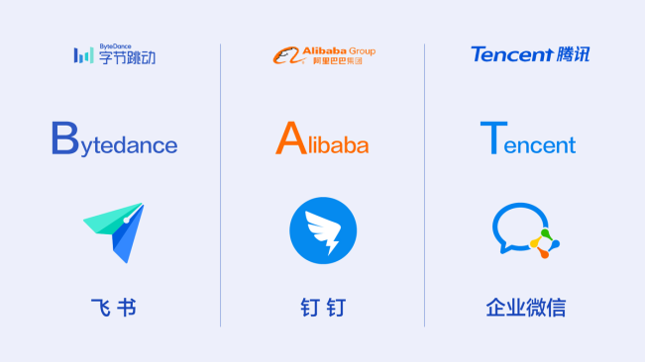
A bit about myself
Infrastructure engineer, ~5y
Enterprise instant messenger project
Auth & resilience: ~10 types of tokens per day
Motivations
Opportunity to learn big picture

Slide 3
Approach
A talk between SD interview and real sys. e.g.
Mini scenario: Group chat
Most general solution: e.g. storage - relational DB
Logical designs, not choosing tech stack
No common cross-cutting concerns e.g. sharding, monitoring
Q&A anytime

Slide 4
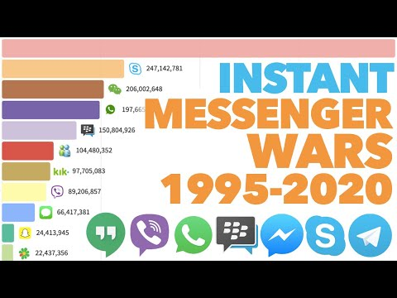
History
Ref 1995-2020

Slide 5
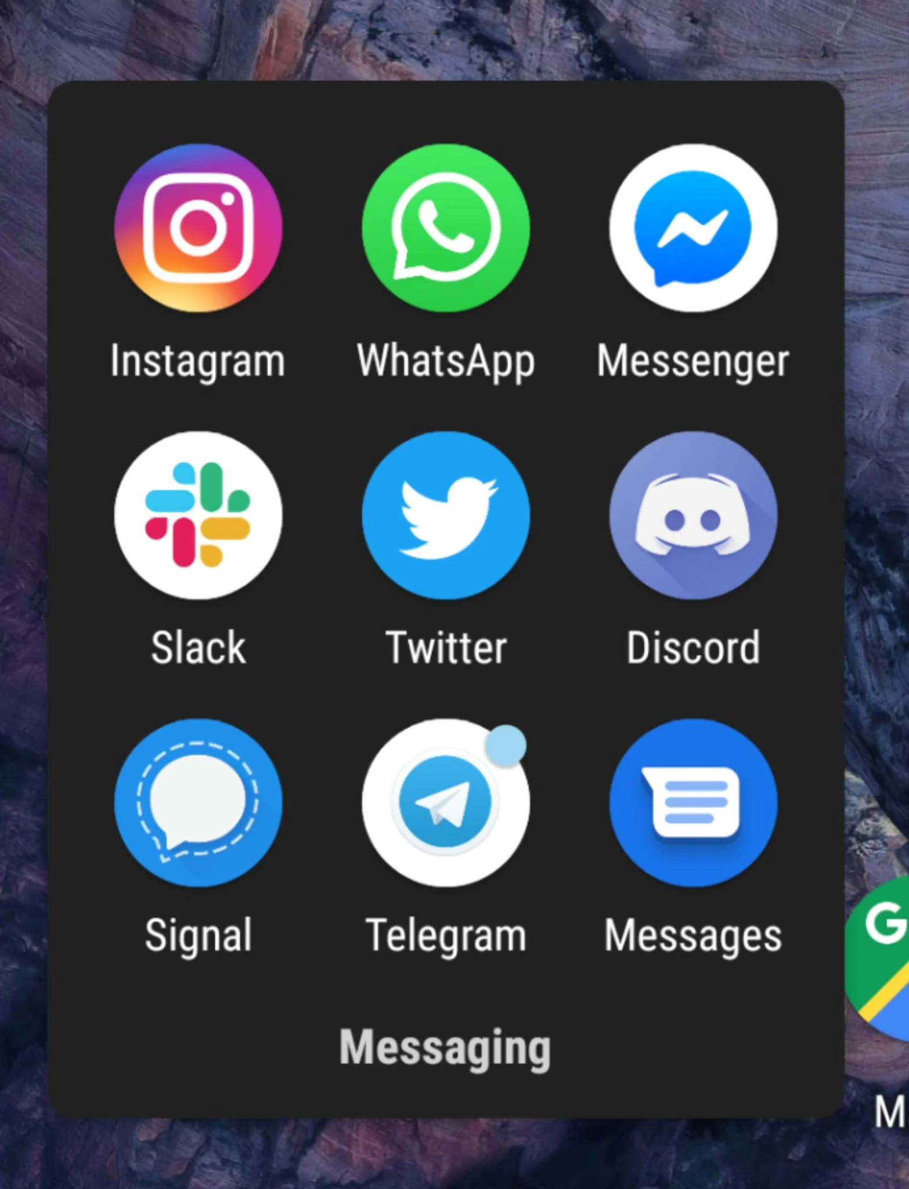
Now
Why a folder of chat apps?
Notes:
Event sourcing and chat app: https://blog.bitsrc.io/event-sourcing-pattern-for-real-time-frontends-42359e6dd957
I use WhatsApp with my Dutch friends, Telegram with those who switched away, Messenger with New Zealand family, Signal with the technology-focused crowd, Discord with my gaming friends, iMessage with my parents, and Twitter DMs with internet friends.

Slide 6
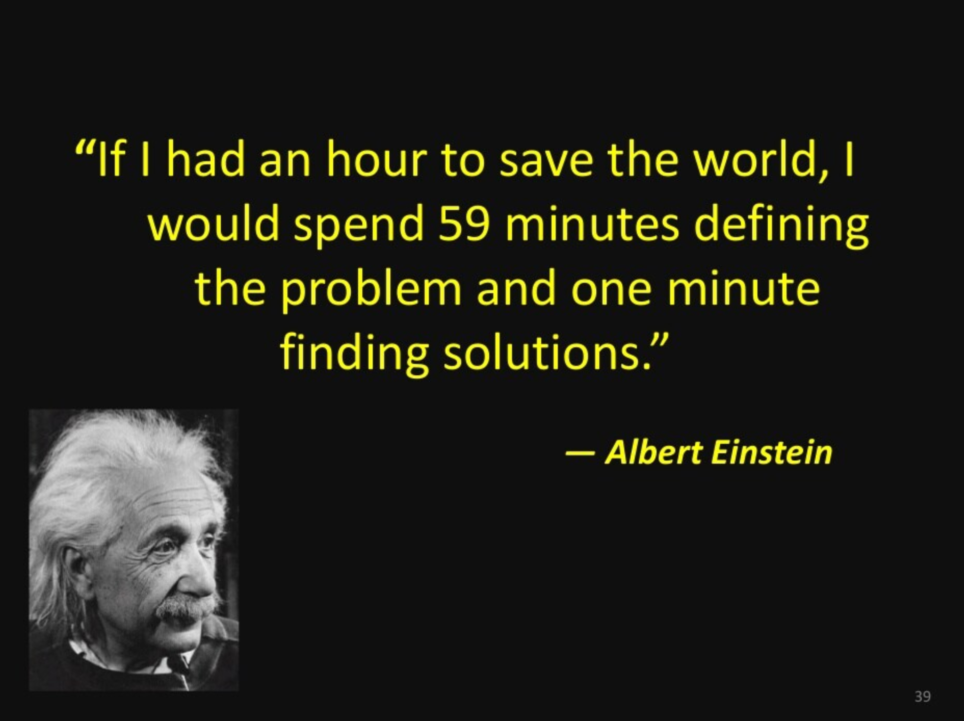
Problem def
Notes:
Event sourcing and chat app: https://blog.bitsrc.io/event-sourcing-pattern-for-real-time-frontends-42359e6dd957

Slide 7
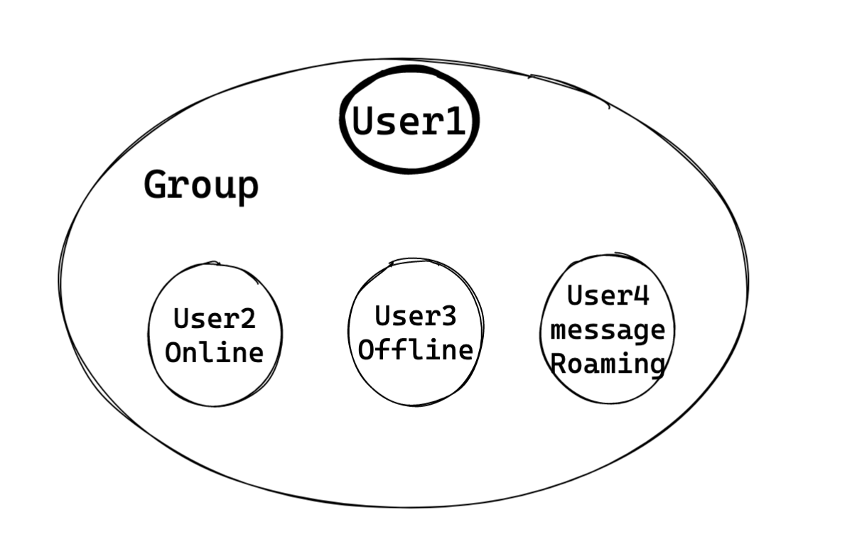
Group chat - Scenario

Slide 8
Problem def: Comparison on group chat scenario
 | Snapchat | WhatsApp | Broadcast chatroom | Slack | What we want to design
Max chat group size | 100 | 256 | No membership concept. 11.2M for Royal wedding) | 10K level (e.g. Microsoft Teams limitations 25K) | Fixed group membership. 500
Send multi-media | Voice, video, image (filters) | Yes (most typical files) | Chat only and reactions | All file types | No
Anything security / Privacy | Disappearing msgs | E2E encryption | No | No consumer functions. But enterprise compliance | No
History msg on cloud | No | No. All on client devices | No. Even fine to drop msgs. No search func | Yes. Complex query demands | 1.Stores on cloud. 2.Search around a time range

Slide 9
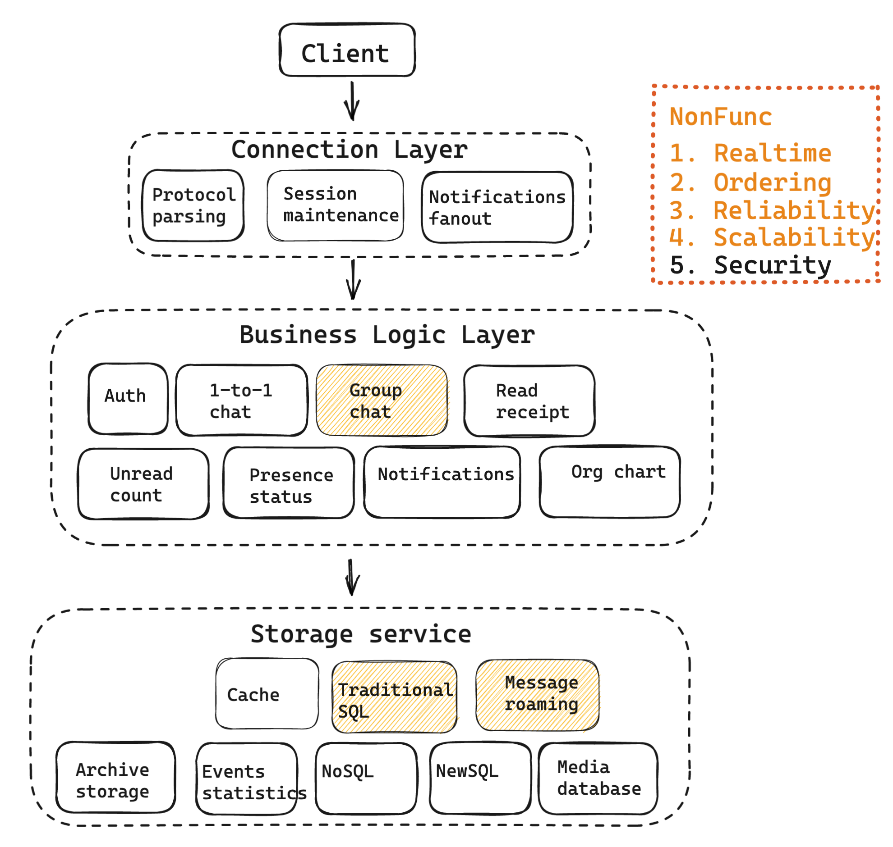
Typical IM system architecture
Additional connection layer
Avoid client to reconnect
Separation of concerns

Slide 10
Outline

Slide 11
Group chat - Scenario

Slide 12
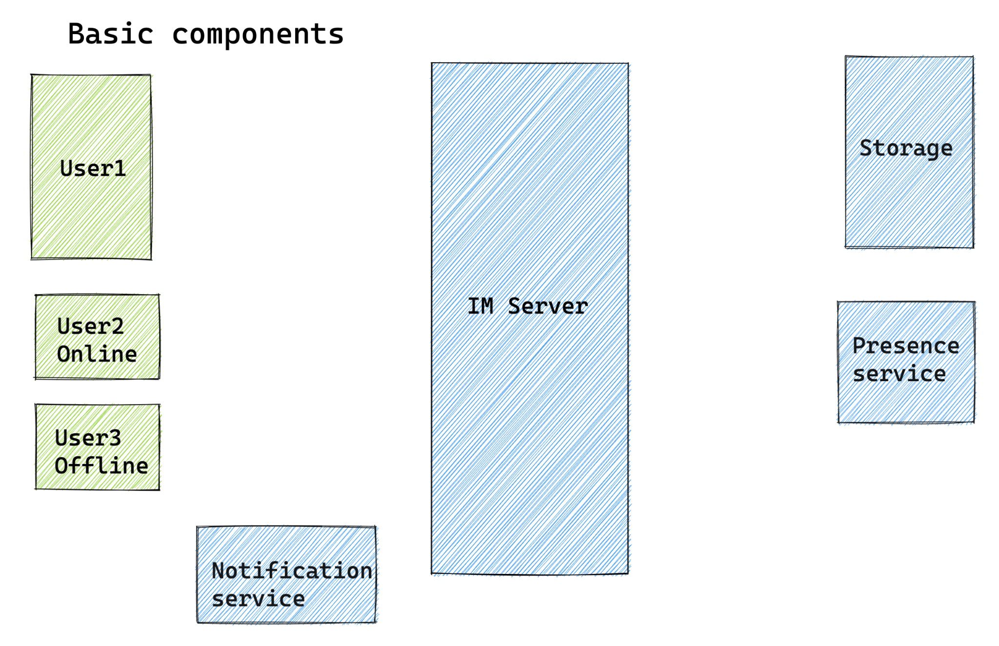
Group chat - Basic components

Slide 13
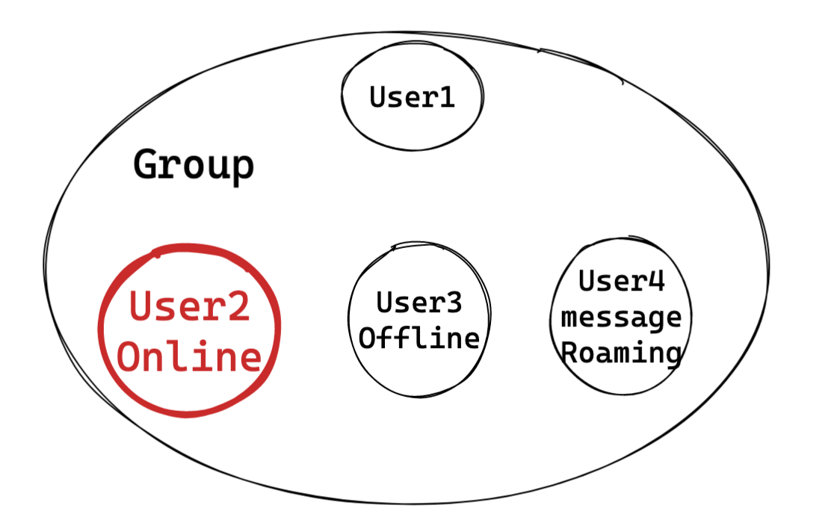
Group chat - Scenario

Slide 14
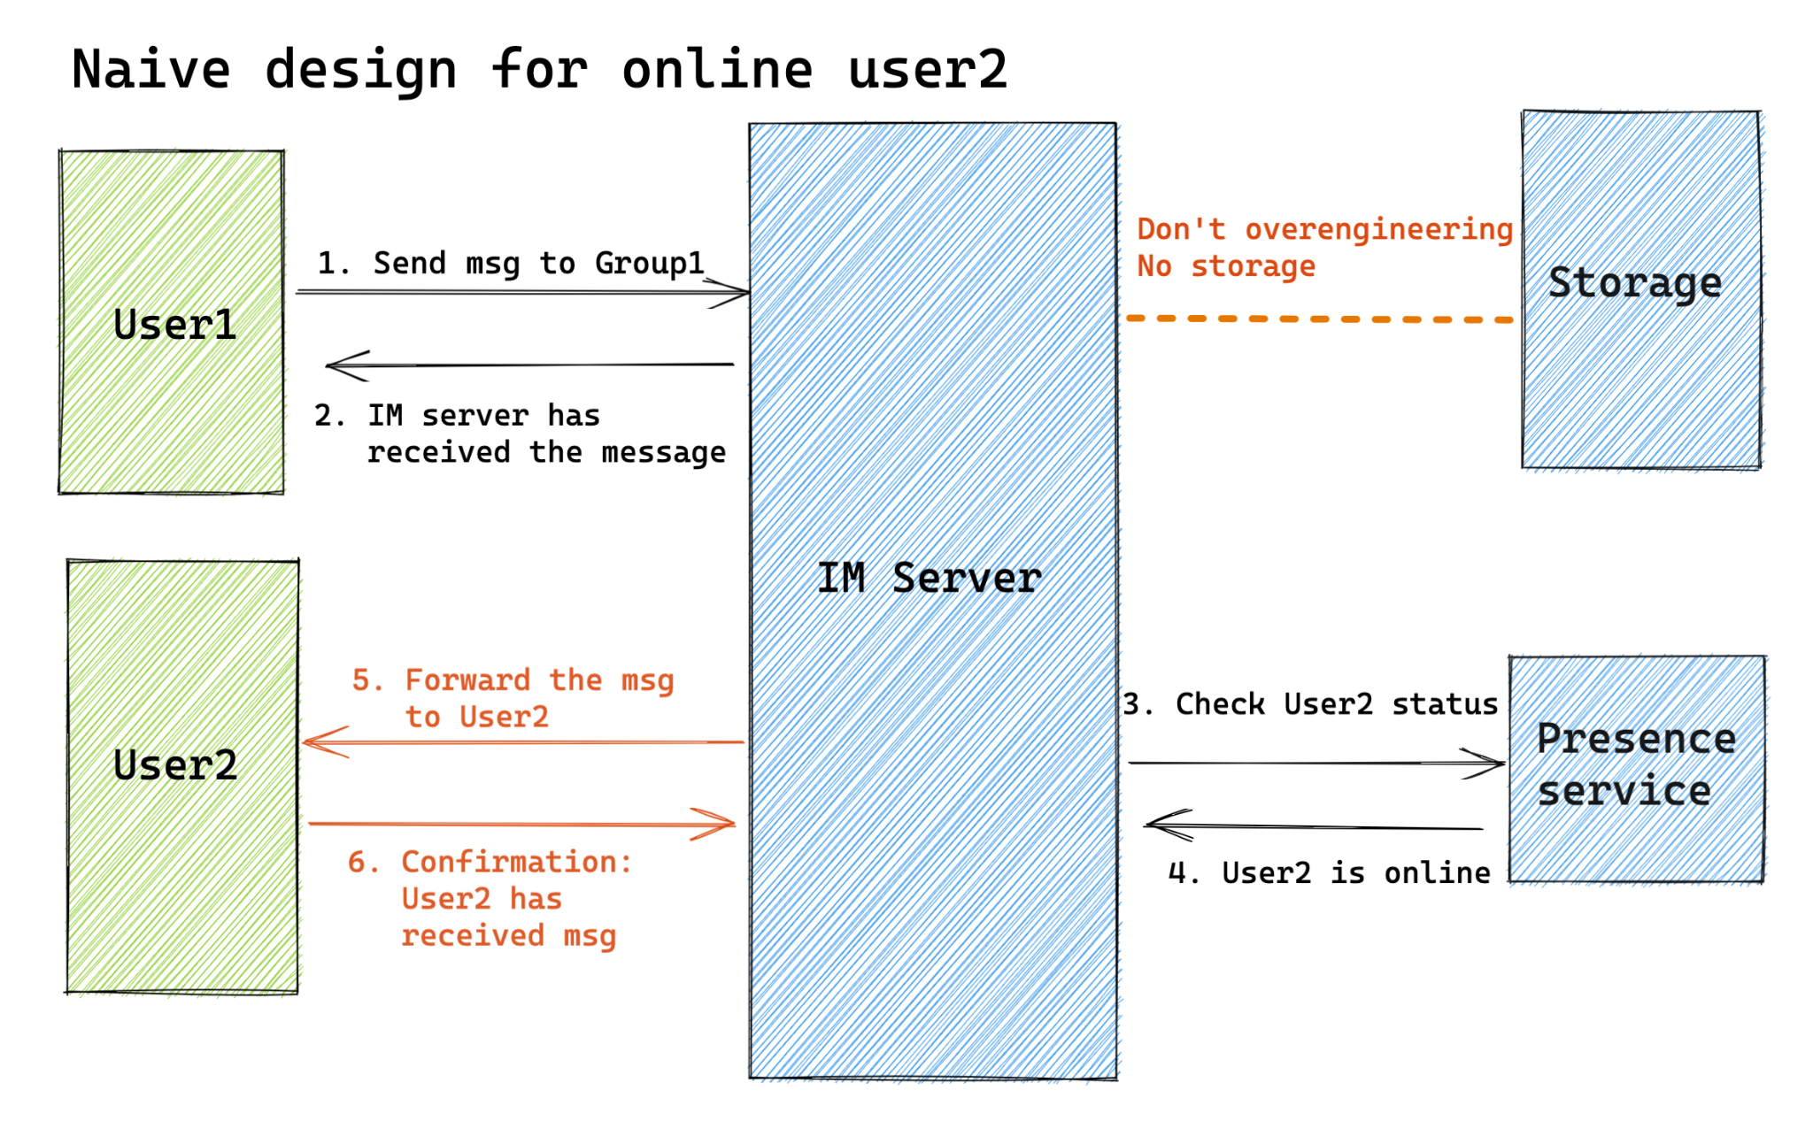
Group chat - User2 as online receivers
Online users
Right on chat conversation
Push or Pull?
Need storage?
Notes:
User2 pull from IM server every X seconds
Waste of resources
Latency in getting messages
IM server push to User2 because User2 is online - Preferred
Problems in Step5/6:
Client B becomes offline after Step3/4
IM server crashes after step2
…

Slide 15
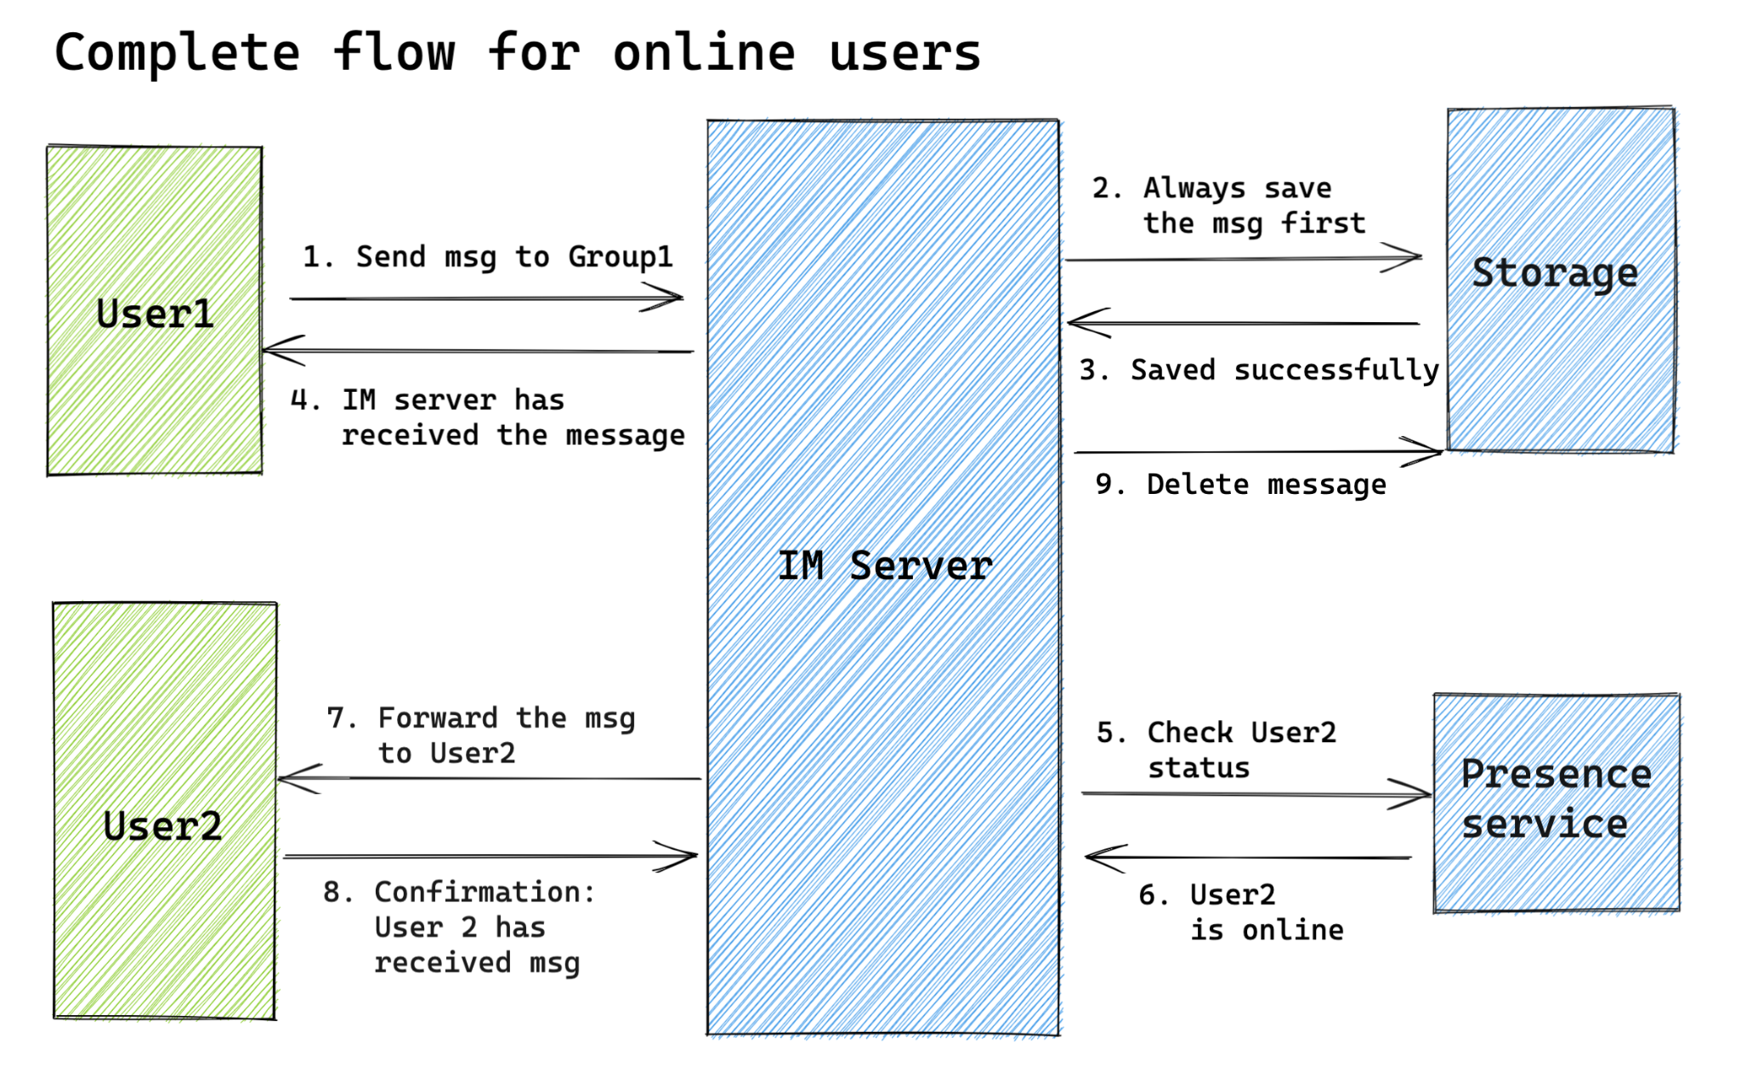
Group chat - User2 as online receivers
Basic flow

Slide 16
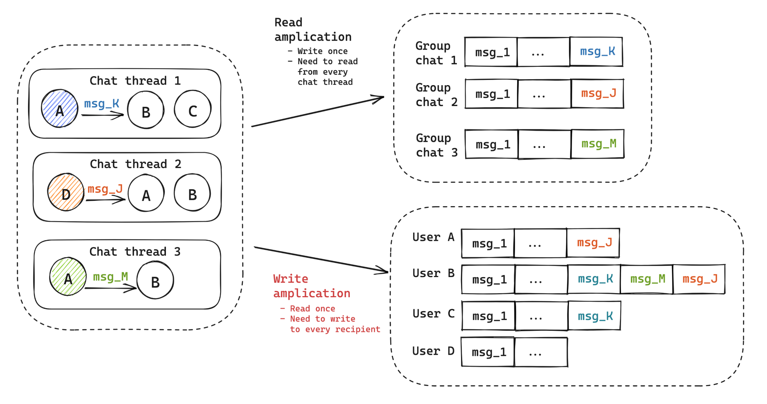
Group chat - User2 as online receivers
How do we save group messages?
Read amplification
Write to each group
Write amplification
Write to each user
Prefer write amplification
1 write: 100 reads, try to make read easier
Group size not too big

Slide 17
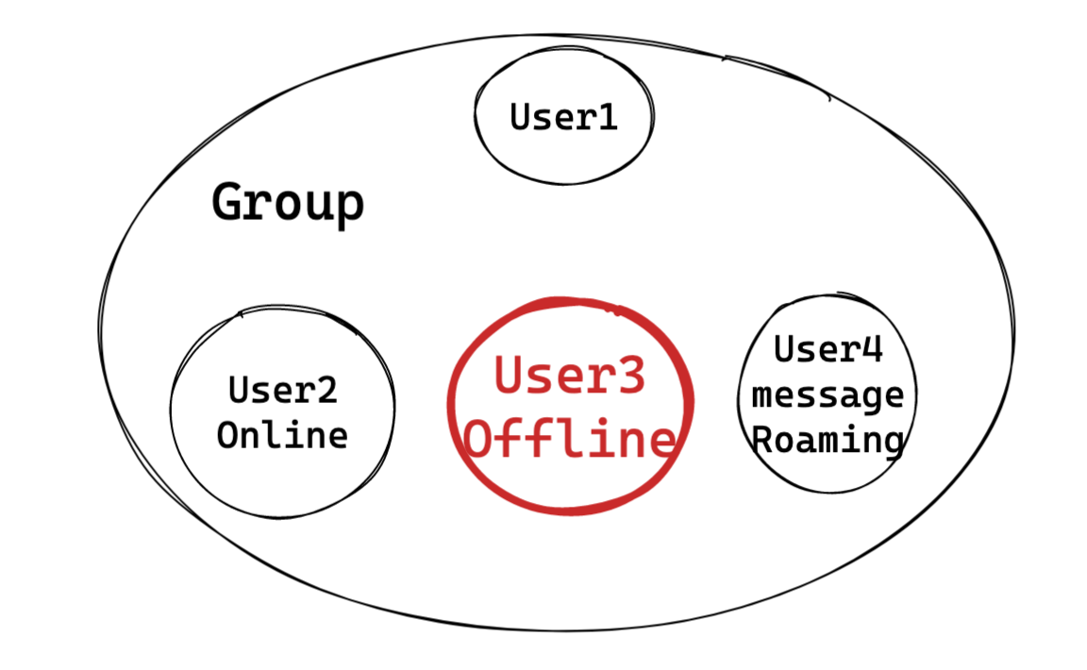
Group chat - Scenario

Slide 18
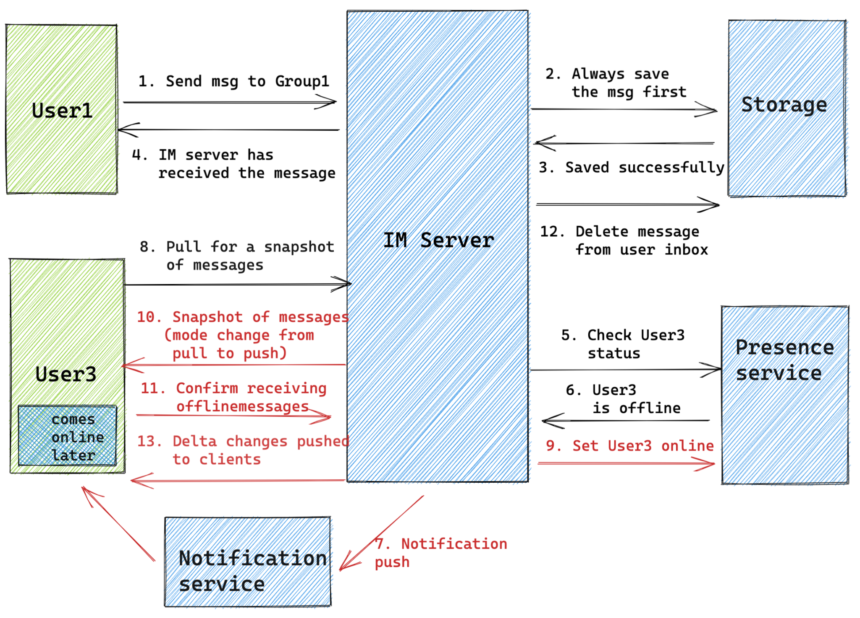
Group chat - User3 as offline receivers
Offline users
On other chats
App in background
App closed
Push or Pull
Notes:
Facebook combined approach of pull and push: https://sudarakayasindu.medium.com/behind-the-scenes-of-chat-applications-38634f584758
What happens when offline users come online?
It needs to send a signal to server (Pull)
After pulling all offline messages, it could be treated the same way as online users using push
A combined approach:
Client makes a pull for a snapshot of messages
Client receives a snapshot of messages and get subscribed to receive delta updates
New messages are pushed to clients

Slide 19
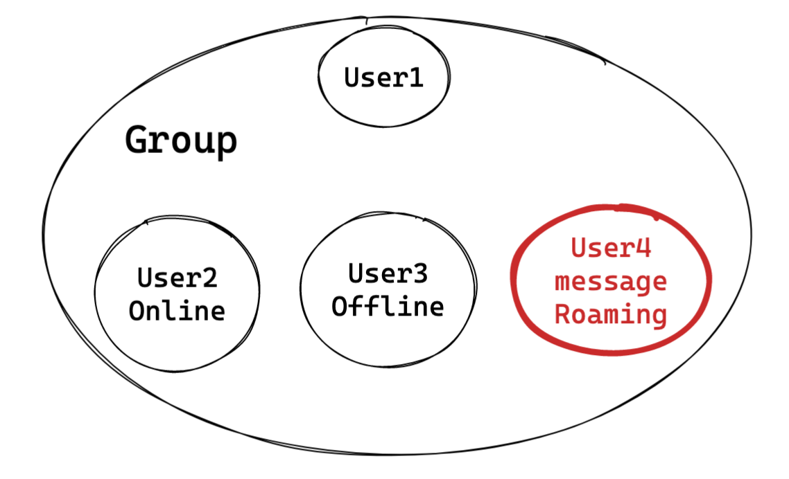
Group chat - Scenario

Slide 20
Group chat - Message roaming
 |  | Online/Offline message buffer | Message roaming
Diff | Sync triggers | User opens the app After network jittery | User installs a new IM app and scrolls up a group chat
 | Freq | High | Low
 | Retention limit | Several weeks to months. Upper num of msgs (e.g. 10K) | Years or forever No limitation
Solution | Storage pattern | Write amplification Stored by user | Read amplification Stored by chat group
 | Storage engine | Write throughput, timeout, range query E.g. Redis SortedSet Ref 1, Ref2 Traditional SQL | Persistence, range query, large vol E.g.HBase Ref1, Timeline model Ref2 Traditional SQL,

Slide 21
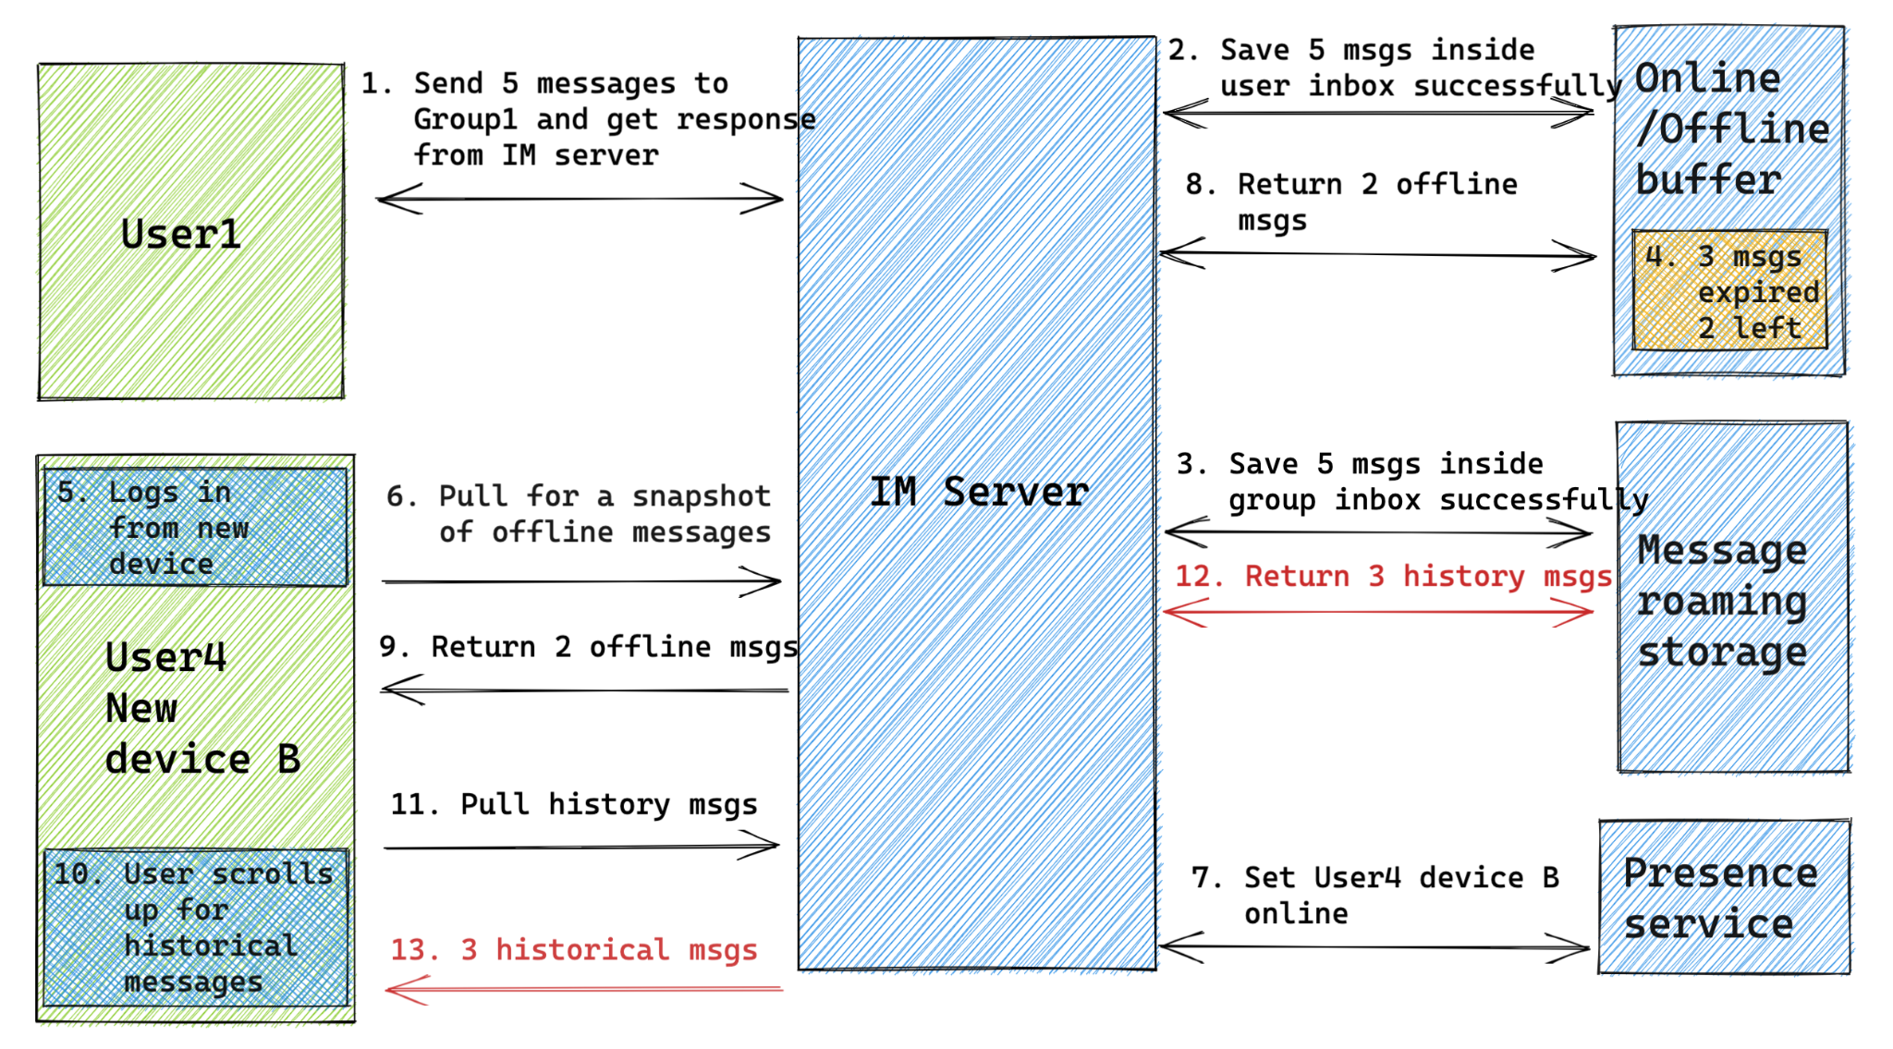
Group chat - Message roaming
Message roaming:
Get history msgs from group chat on scroll up
Get 2 on log in and 3 on history
Notes:
User1 send 5 msgs in group1 in total
User4 logs in from a new device B
On logging in, pull 3 msgs from online/offline buffer
User4 device B scrolls up in chat in group1 for historical msgs
2 historical msgs are pulled from message roaming storage

Slide 22
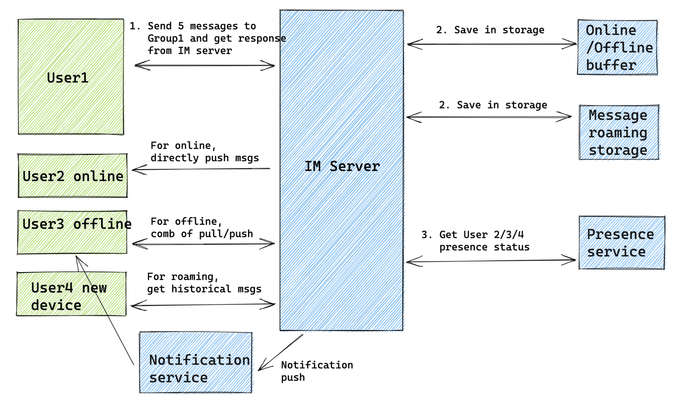
Overall naive flow

Slide 23
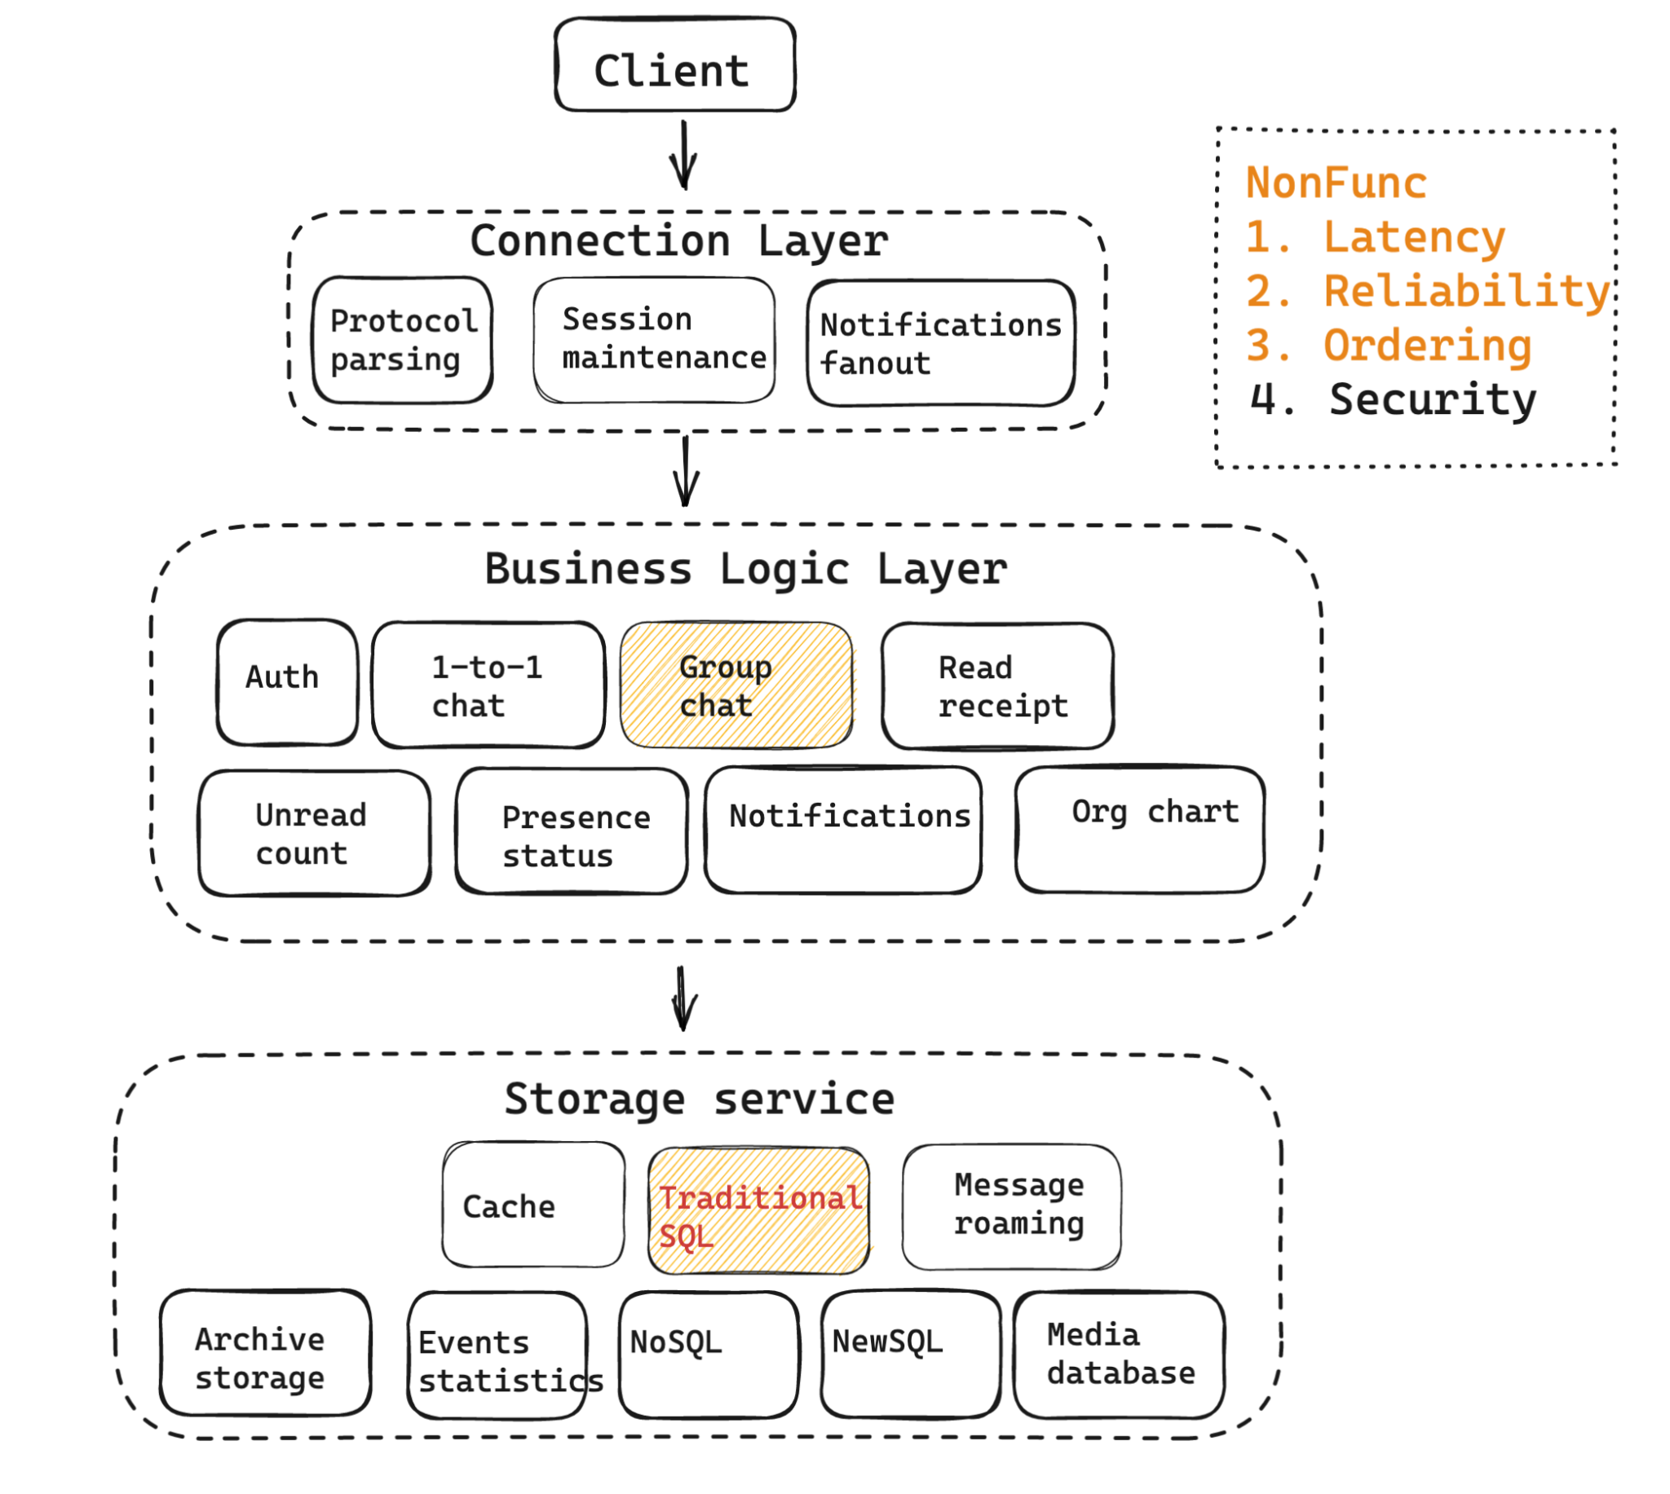
Outline

Slide 24
Group chat - Storage
 |  | Online/Offline message buffer | Message roaming
Diff | Sync triggers | User opens the app After network jittery | User installs a new IM app and scrolls up a group chat
 | Freq | High | Low
 | Retention limit | Several weeks to months. Upper num of msgs (e.g. 10K) | Years or forever No limitation
Solution | Storage pattern | Write amplification Stored by user | Read amplification Stored by chat group
 | Storage engine | Write throughput, timeout, range query E.g. Redis SortedSet Ref 1, Ref2 Traditional SQL | Persistence, large vol, range query E.g.HBase Ref1, Timeline model Ref2 Traditional SQL,

Slide 25
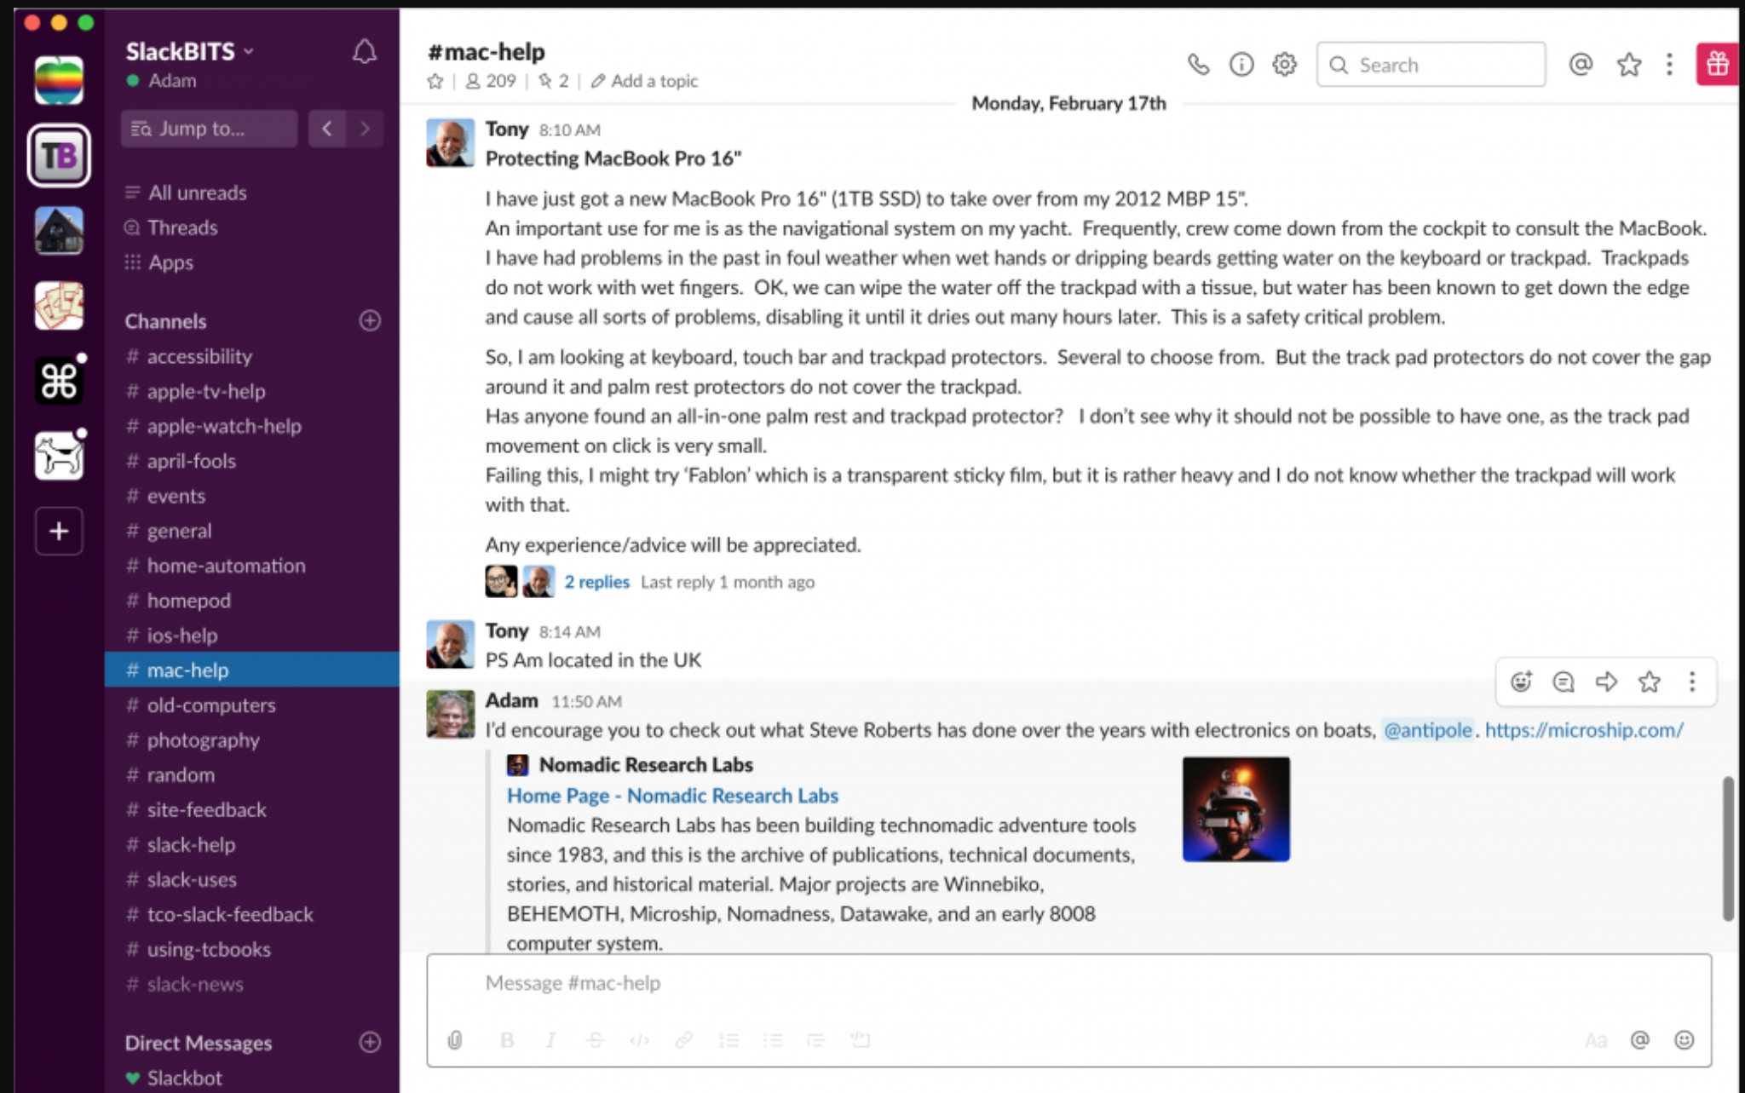
Group chat - Simplified storage requirements
Redis vs SQL
On user login to a chat app,
Requirement1:
For a given user, load all active group chat after last sync
Requirement2:
For each active group chat, load msgs
after last sync
Notes:
瓜子存储overview: http://www.52im.net/thread-2807-1-1.html

Slide 26
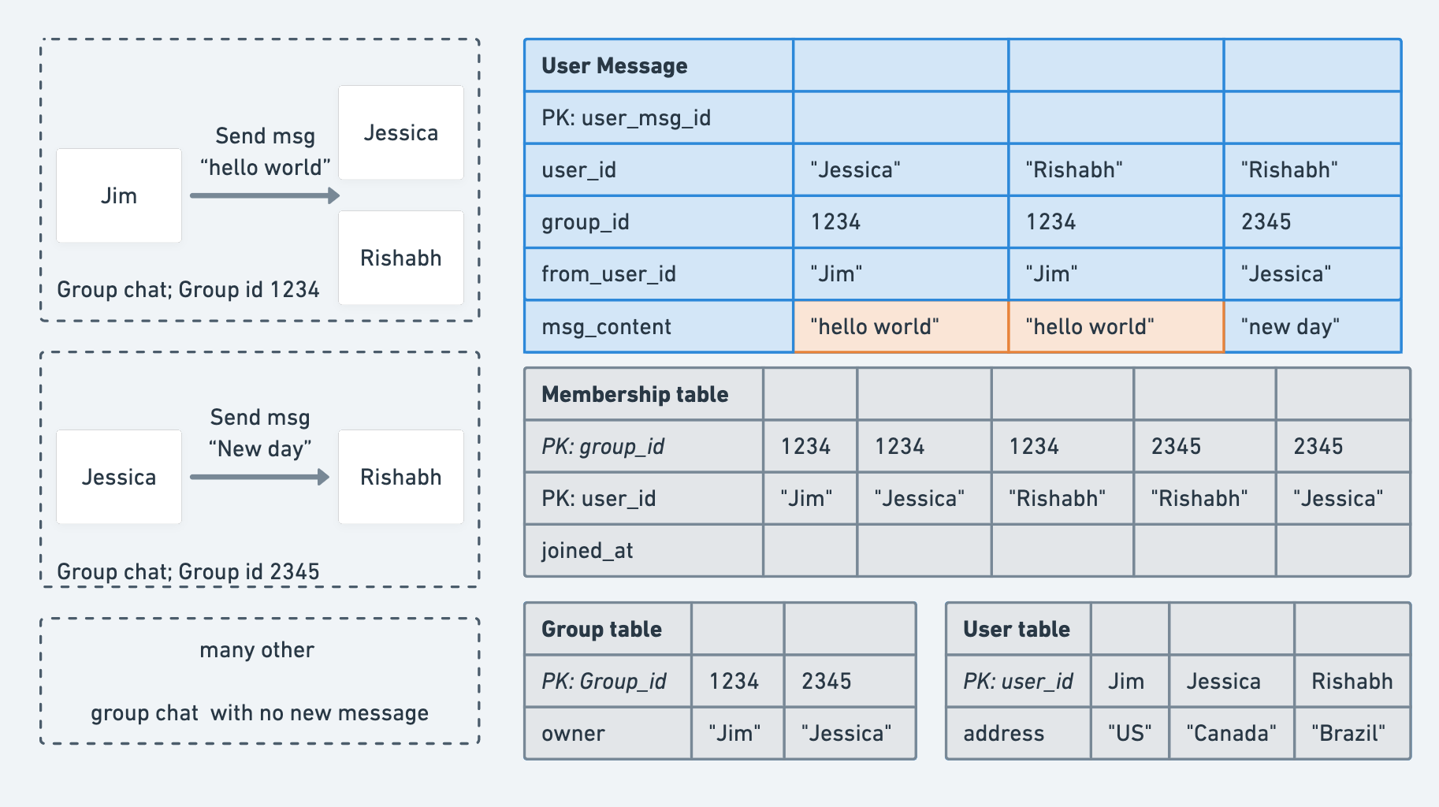
Group chat - Initial scheme with write amplification
Notes:
58到家IM: http://www.52im.net/thread-1616-1-1.html
Write:
// Repeat the same for
// each msg receiver in the group chat
// As an example, Jim sends a group chat to 1234
// where Jessica is one of receivers
Insert into UserMessageTable
(user_id, from_user_id, group_id, msg_content)
values
("Jessica", “Jim”, “1234”, “hello world”)
Read:

Slide 27
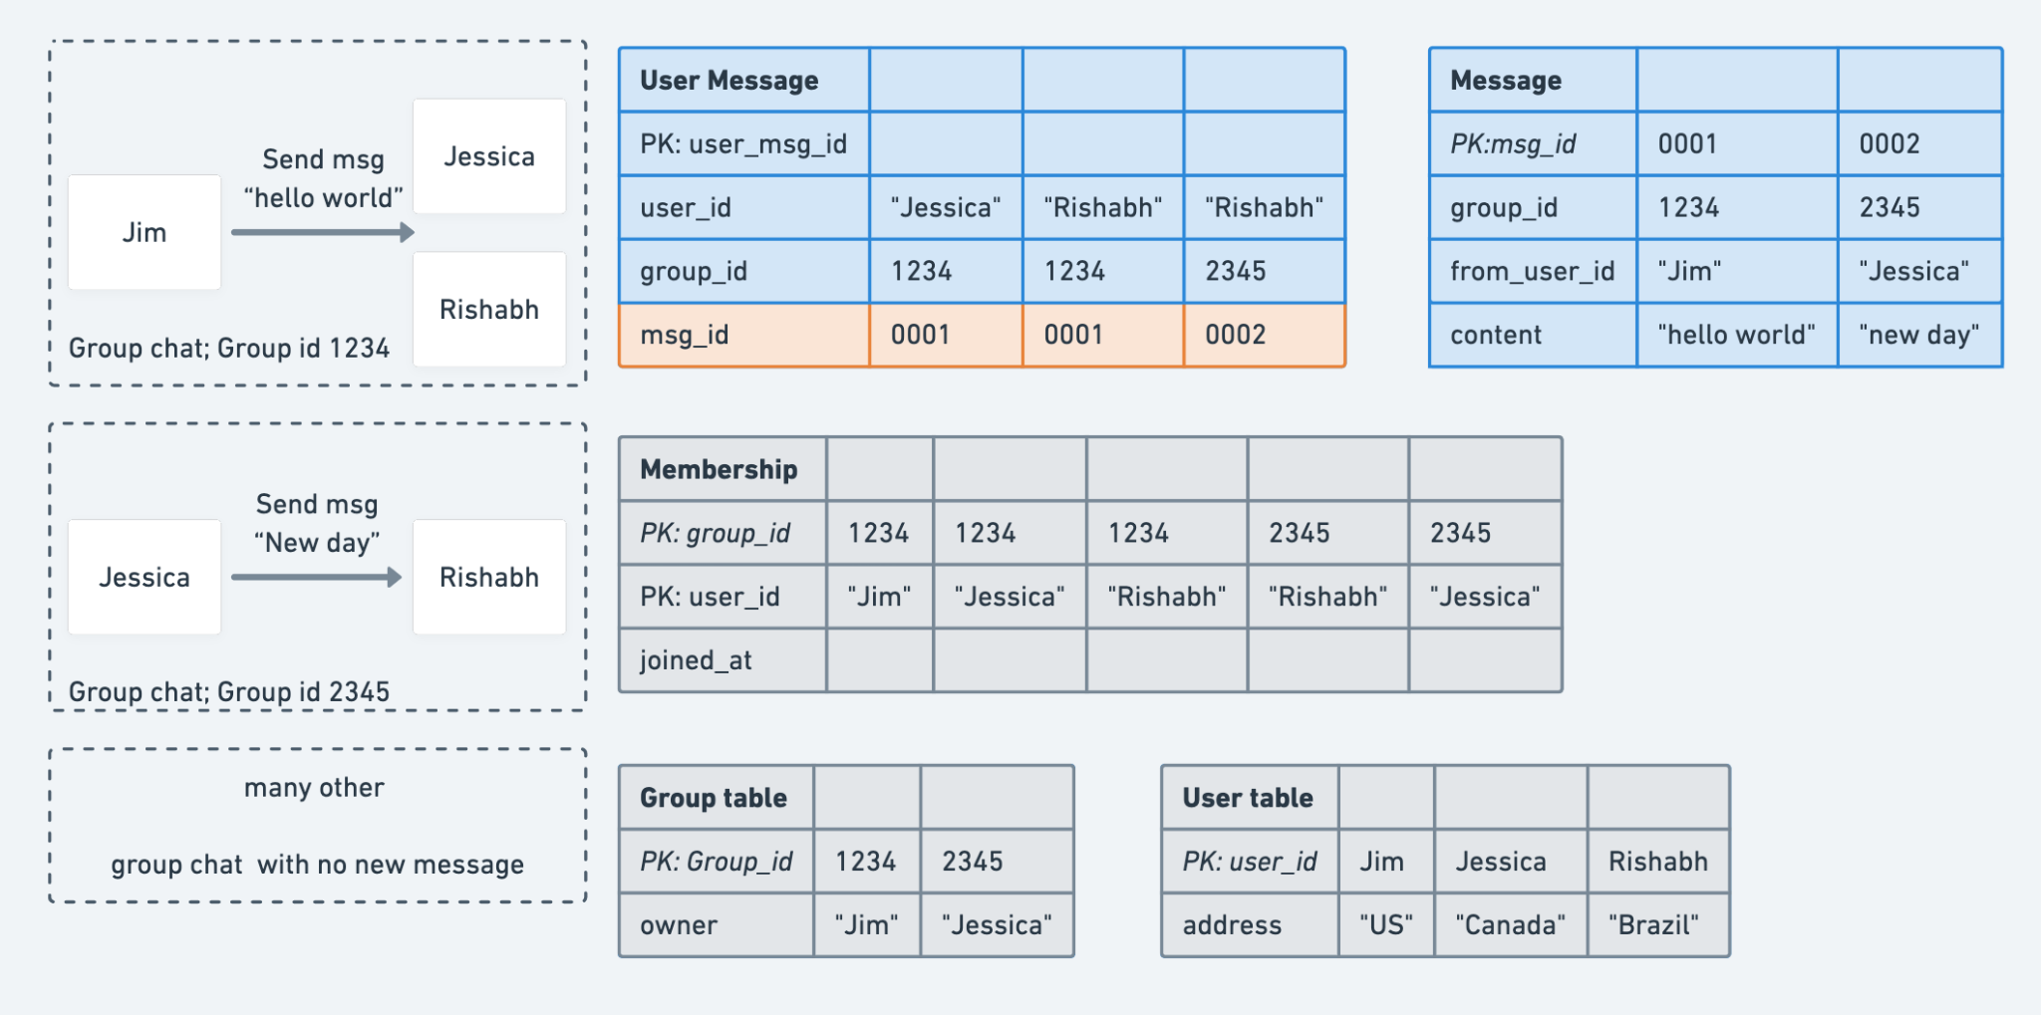
Group chat - Only store one copy of msg_content

Slide 28
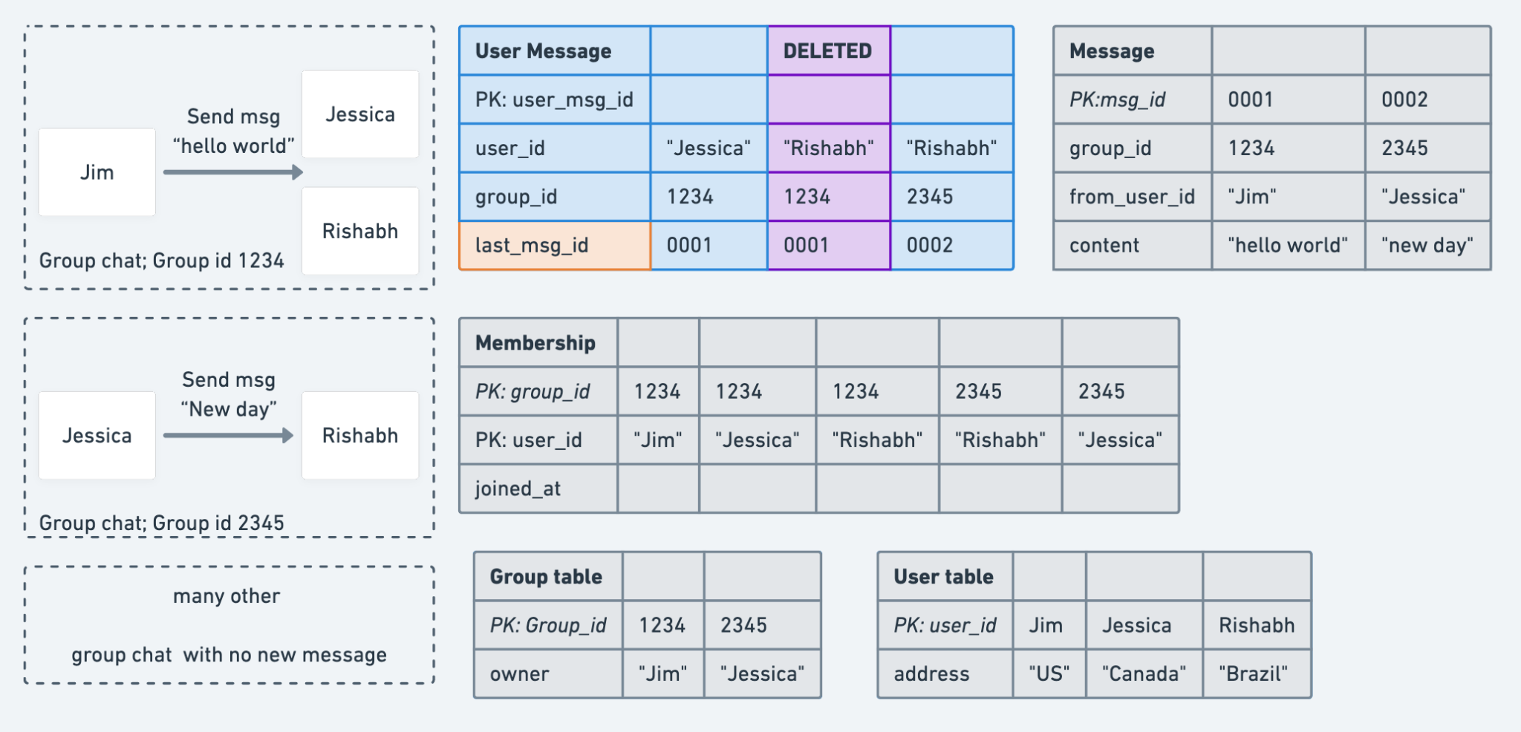
Group chat - Storing only the latest msg id per user/group
Only store last msg id?
Notes:
Typically, assume msg_id has increasing order, could we store only the latest msg id for each user per group?

Slide 29
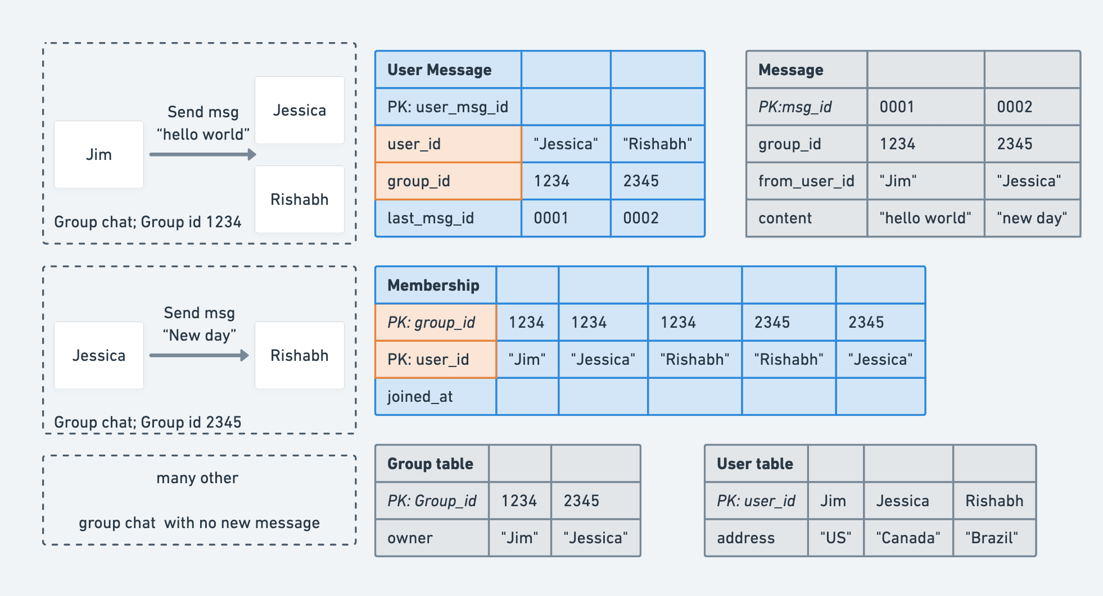
Group chat - Storing only the latest msg id per user/group
Could we do
better?

Slide 30
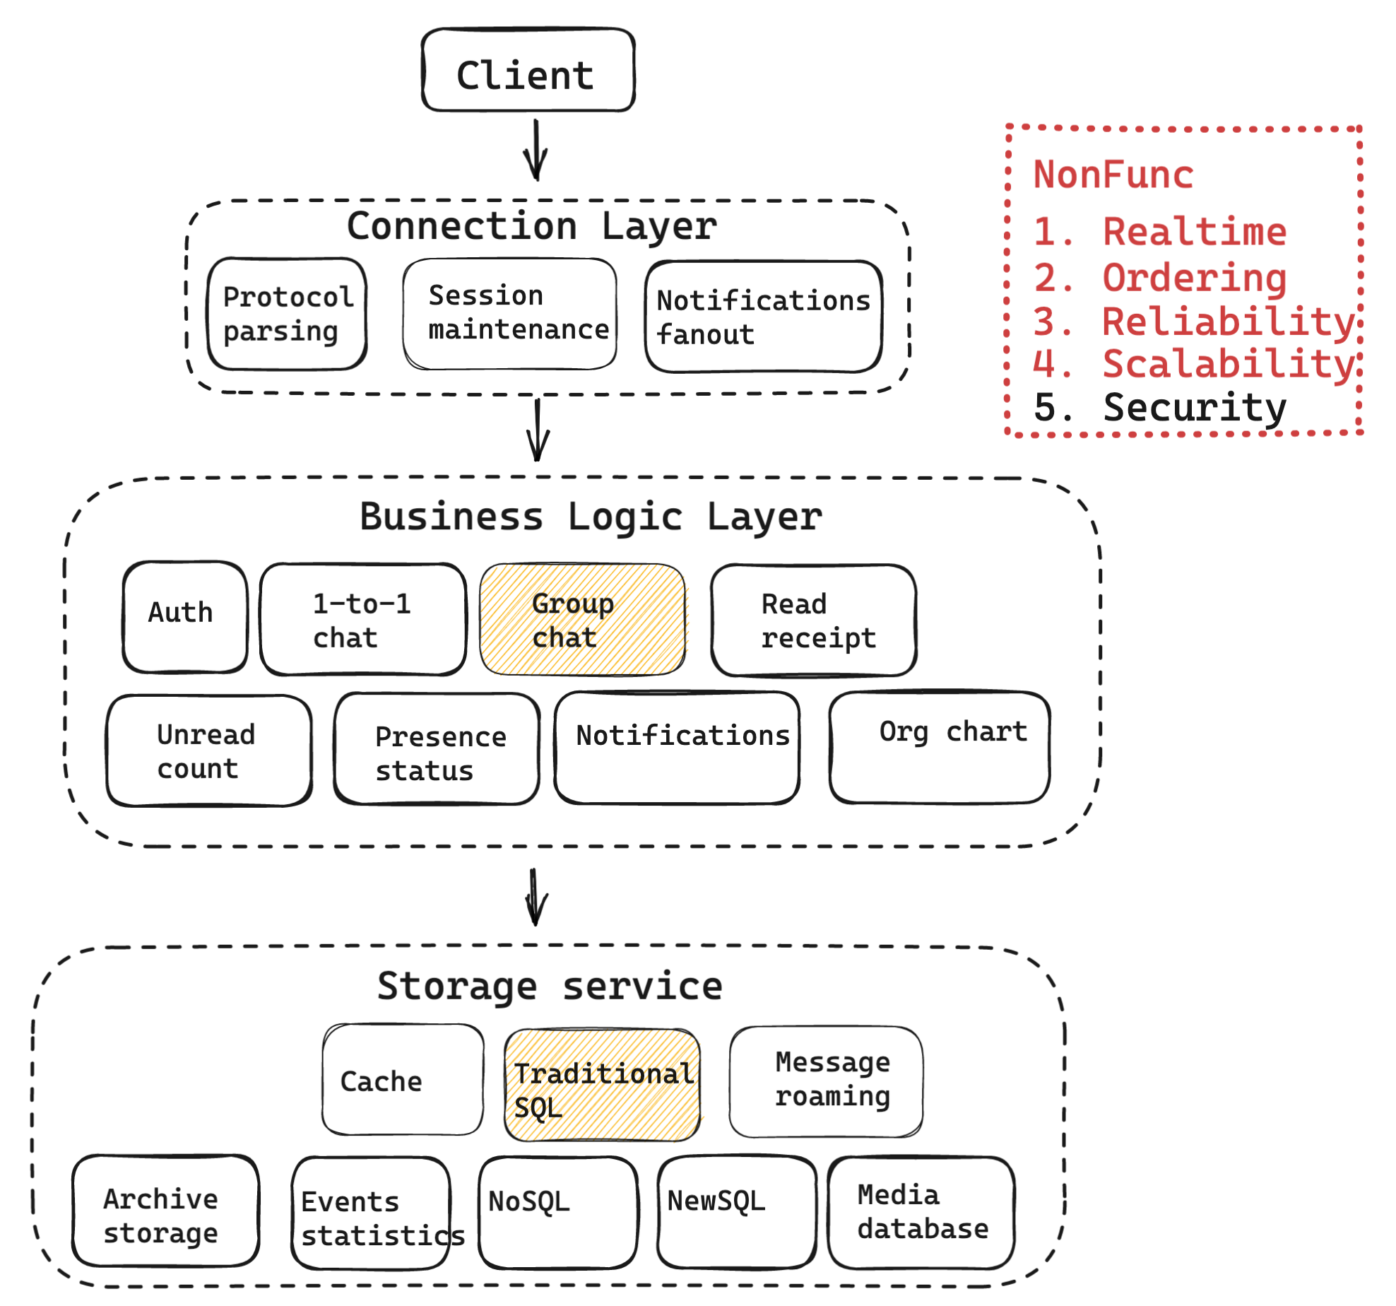
NonFunc
Approach:
Encapsulated problem
Tradeoffs

Slide 31
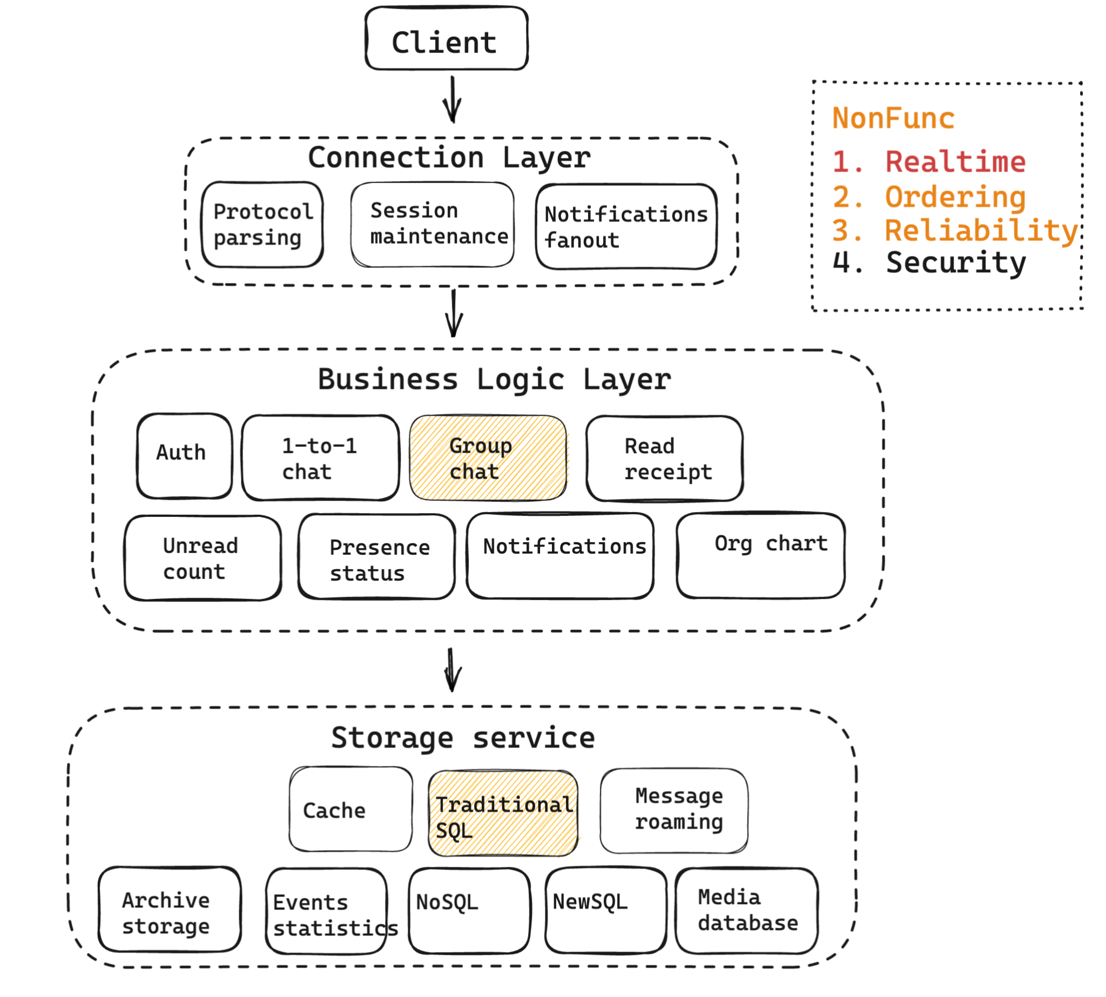
NonFunc - Realtime
Goal:
For online receivers, P99 ~ 300ms
Three ideas
Notes:
http://www.52im.net/thread-3726-1-1.html

Slide 32
NonFunc - Realtime - Protocol
No messaging specific protocols (XMPP, AMQP, etc)
Real time needs to be event driven APIs
 | Short polling | Long polling | Websockets | MQTT | SSE | Webhook | Streaming protocol
Throughput | Low | Low | Moderate | Low | Moderate | Low | High
Birectional | No | No | Yes | Yes | No | Yes | No
Initiator | Client | Client | Client | Client | Client | Server | Server
Example use case | REST | REST | Chat/location apps, HTML5 | IOT | Live events update | Email notification | Kafka based logs
Notes:
https://www.infoq.com/articles/realtime-event-driven-ecosystem/
https://ably.com/blog/websockets-vs-long-polling
https://ably.com/blog/websockets-vs-sse

Slide 33
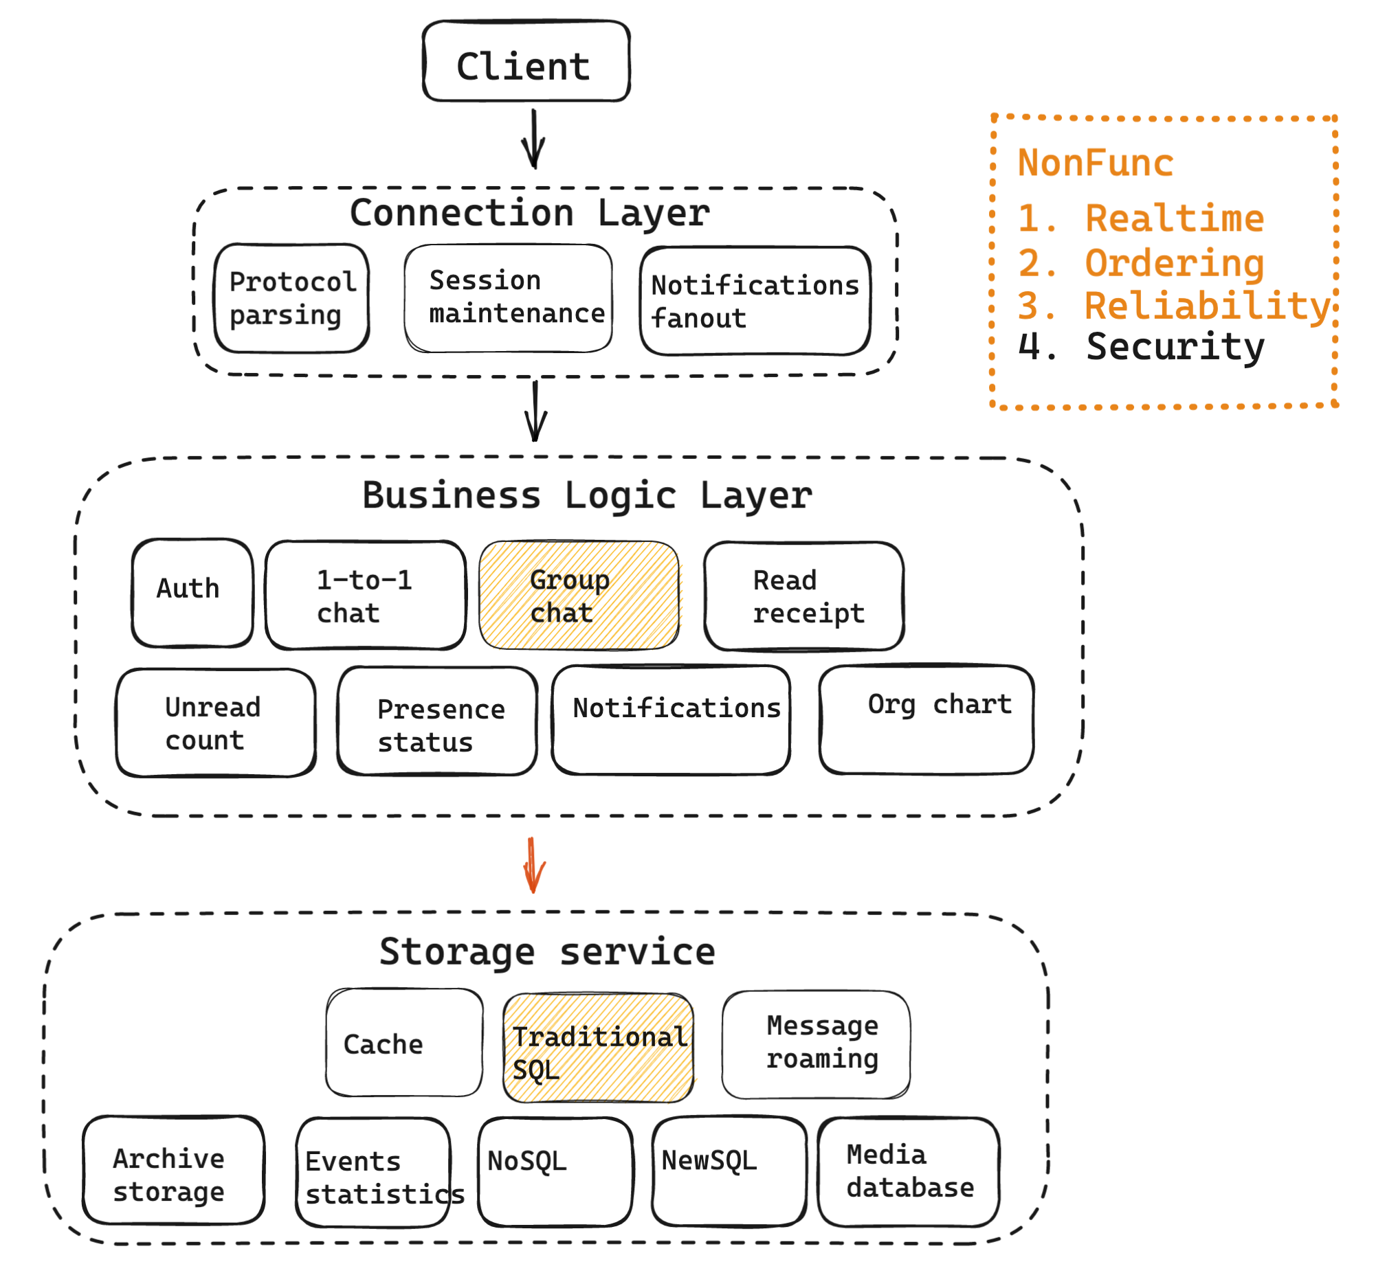
NonFunc - Realtime - DB latency
Biggest delays usually in storage
Asynchronously write to DB
Failure?
Replace RDBMS with Redis (Or Add) Consistency?
……
Notes:
https://www.infoq.com/articles/challenges-realtime-chat-service-pusher/

Slide 34
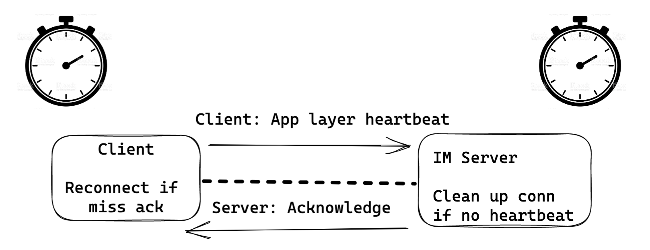
NonFunc - Realtime - App layer heartbeat
Scenario: Weak network,
Online clients’ conn to server broken
App in background, not get notifications
TCP keep-alive not enough
Need app layer heartbeat
Notes:
http://www.52im.net/thread-3726-1-1.html
Network jittery / NAT timeout /mobile network

Slide 35
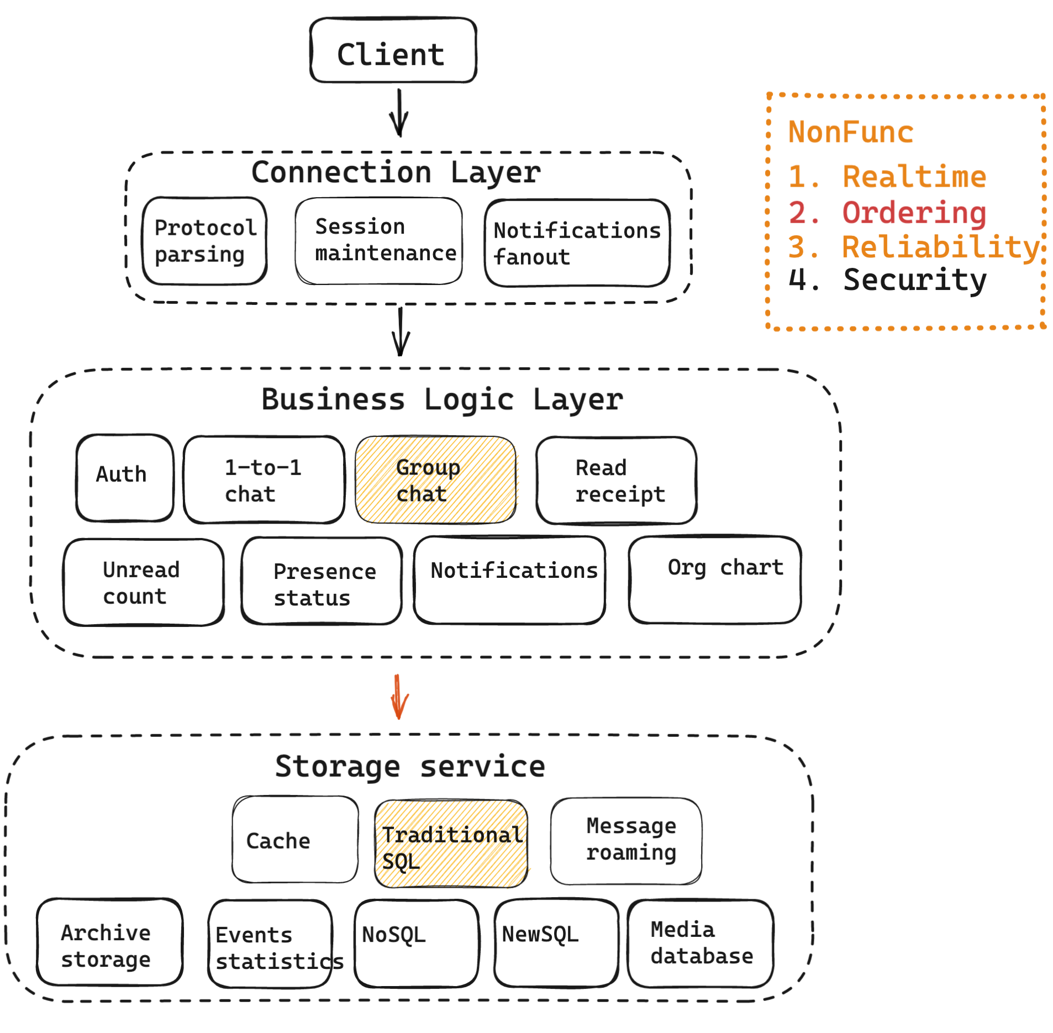
NonFunc - Ordering
Goals:
Consistent order

Slide 36
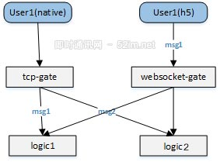
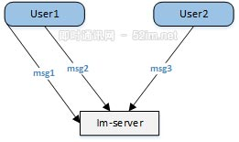
NonFunc - Ordering
Source of misorder:
Network / multi-threading / multi-sender/receiver

Slide 37
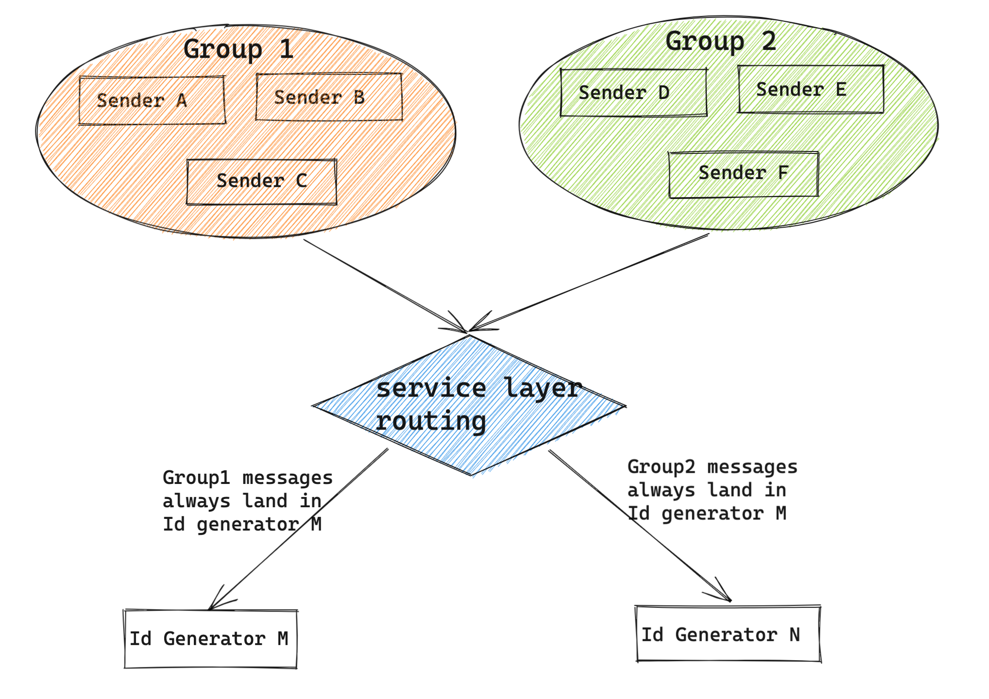
NonFunc - Ordering
Possible approaches
No client/sender ts
Special clock
NTP clock sync (ms level)
Message sequence id

Slide 38
NonFunc - Ordering - MessageID
Requirements:
Ordered per chat
Only (time) range query, No complex query like eComm
High Perf, reliability
 | UUID | Meituan Leaf Segment | Meituan Leaf snowflake | WeChat seqsvr | QQ
Unique dim | Global | Global | Global | Per user | Per chat
Increasing | No | Yes | Yes | Yes | Yes
Continuous | No | Yes | No(for security) | No (for perf) | No
Internal | NA | DB step | Snowflake | Customized | Customized
Notes:
Different types of message ID: https://blog.51cto.com/u_15310381/3200977
Message queue ordering: https://blog.csdn.net/weixin_49794051/article/details/109592639
Message queue ordering2: https://mp.weixin.qq.com/s/vRhhKimP9hYMq6ly7AEQ7Q

Slide 39
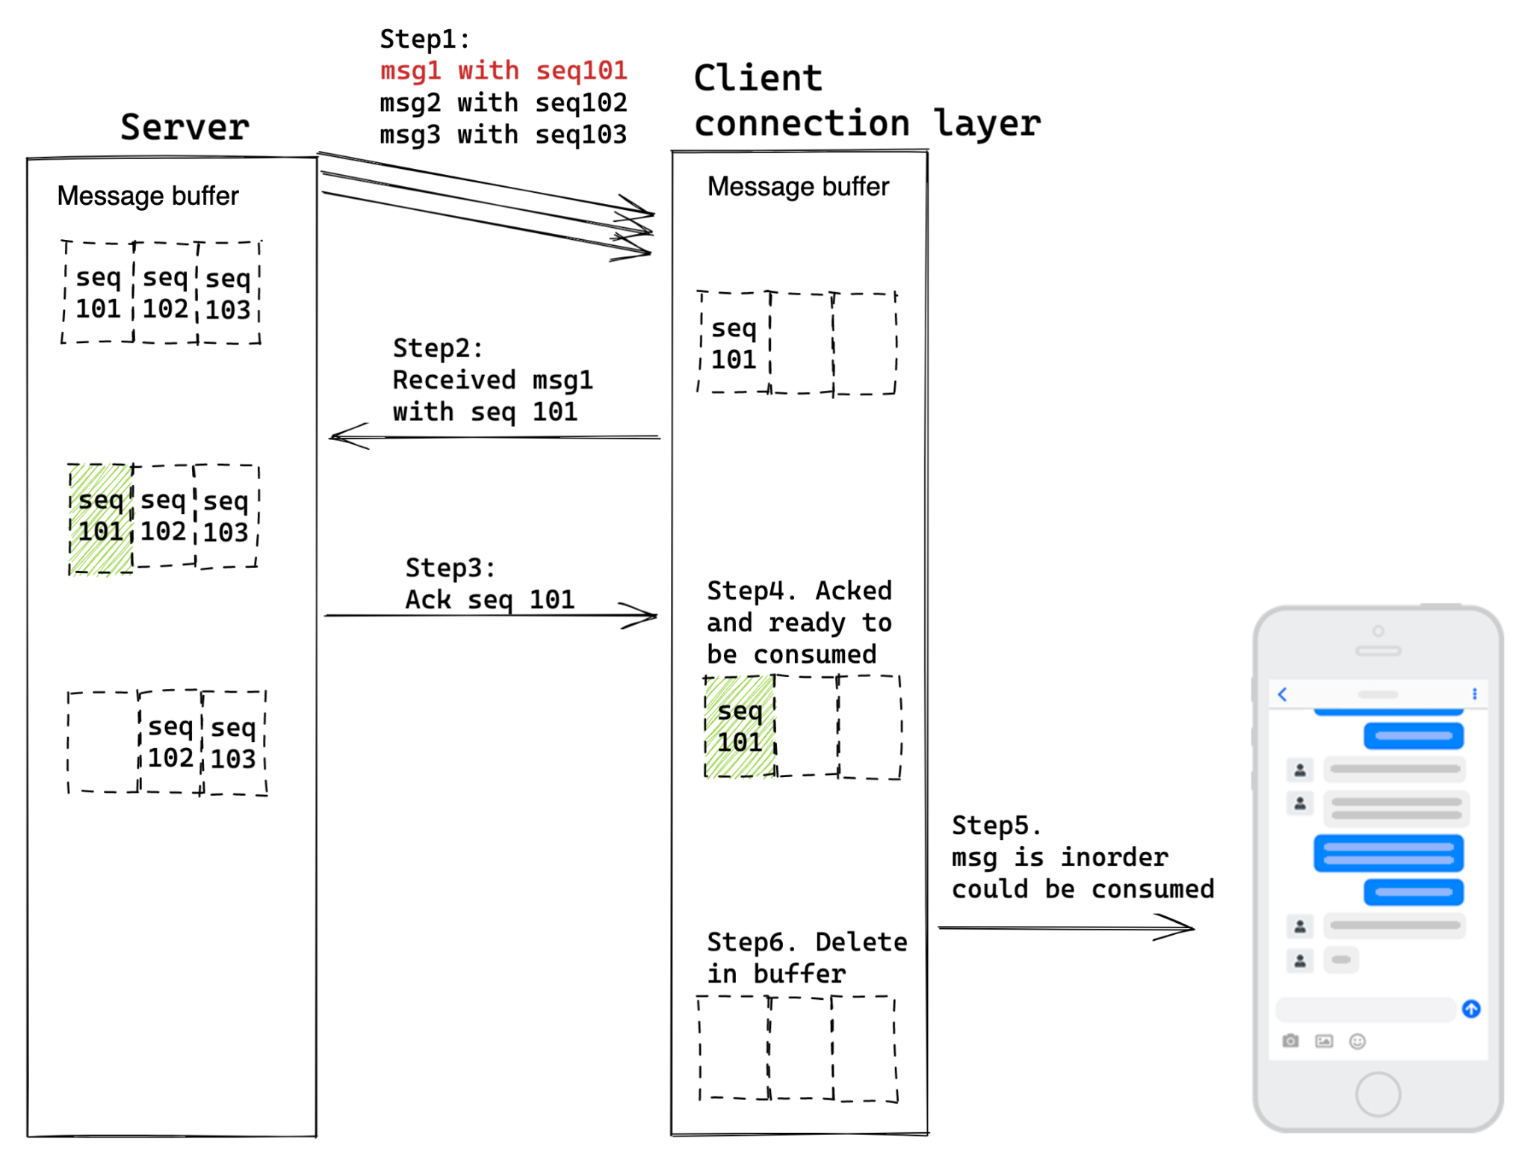
NonFunc - Ordering
Buffer queue
Received inorder msg

Slide 40
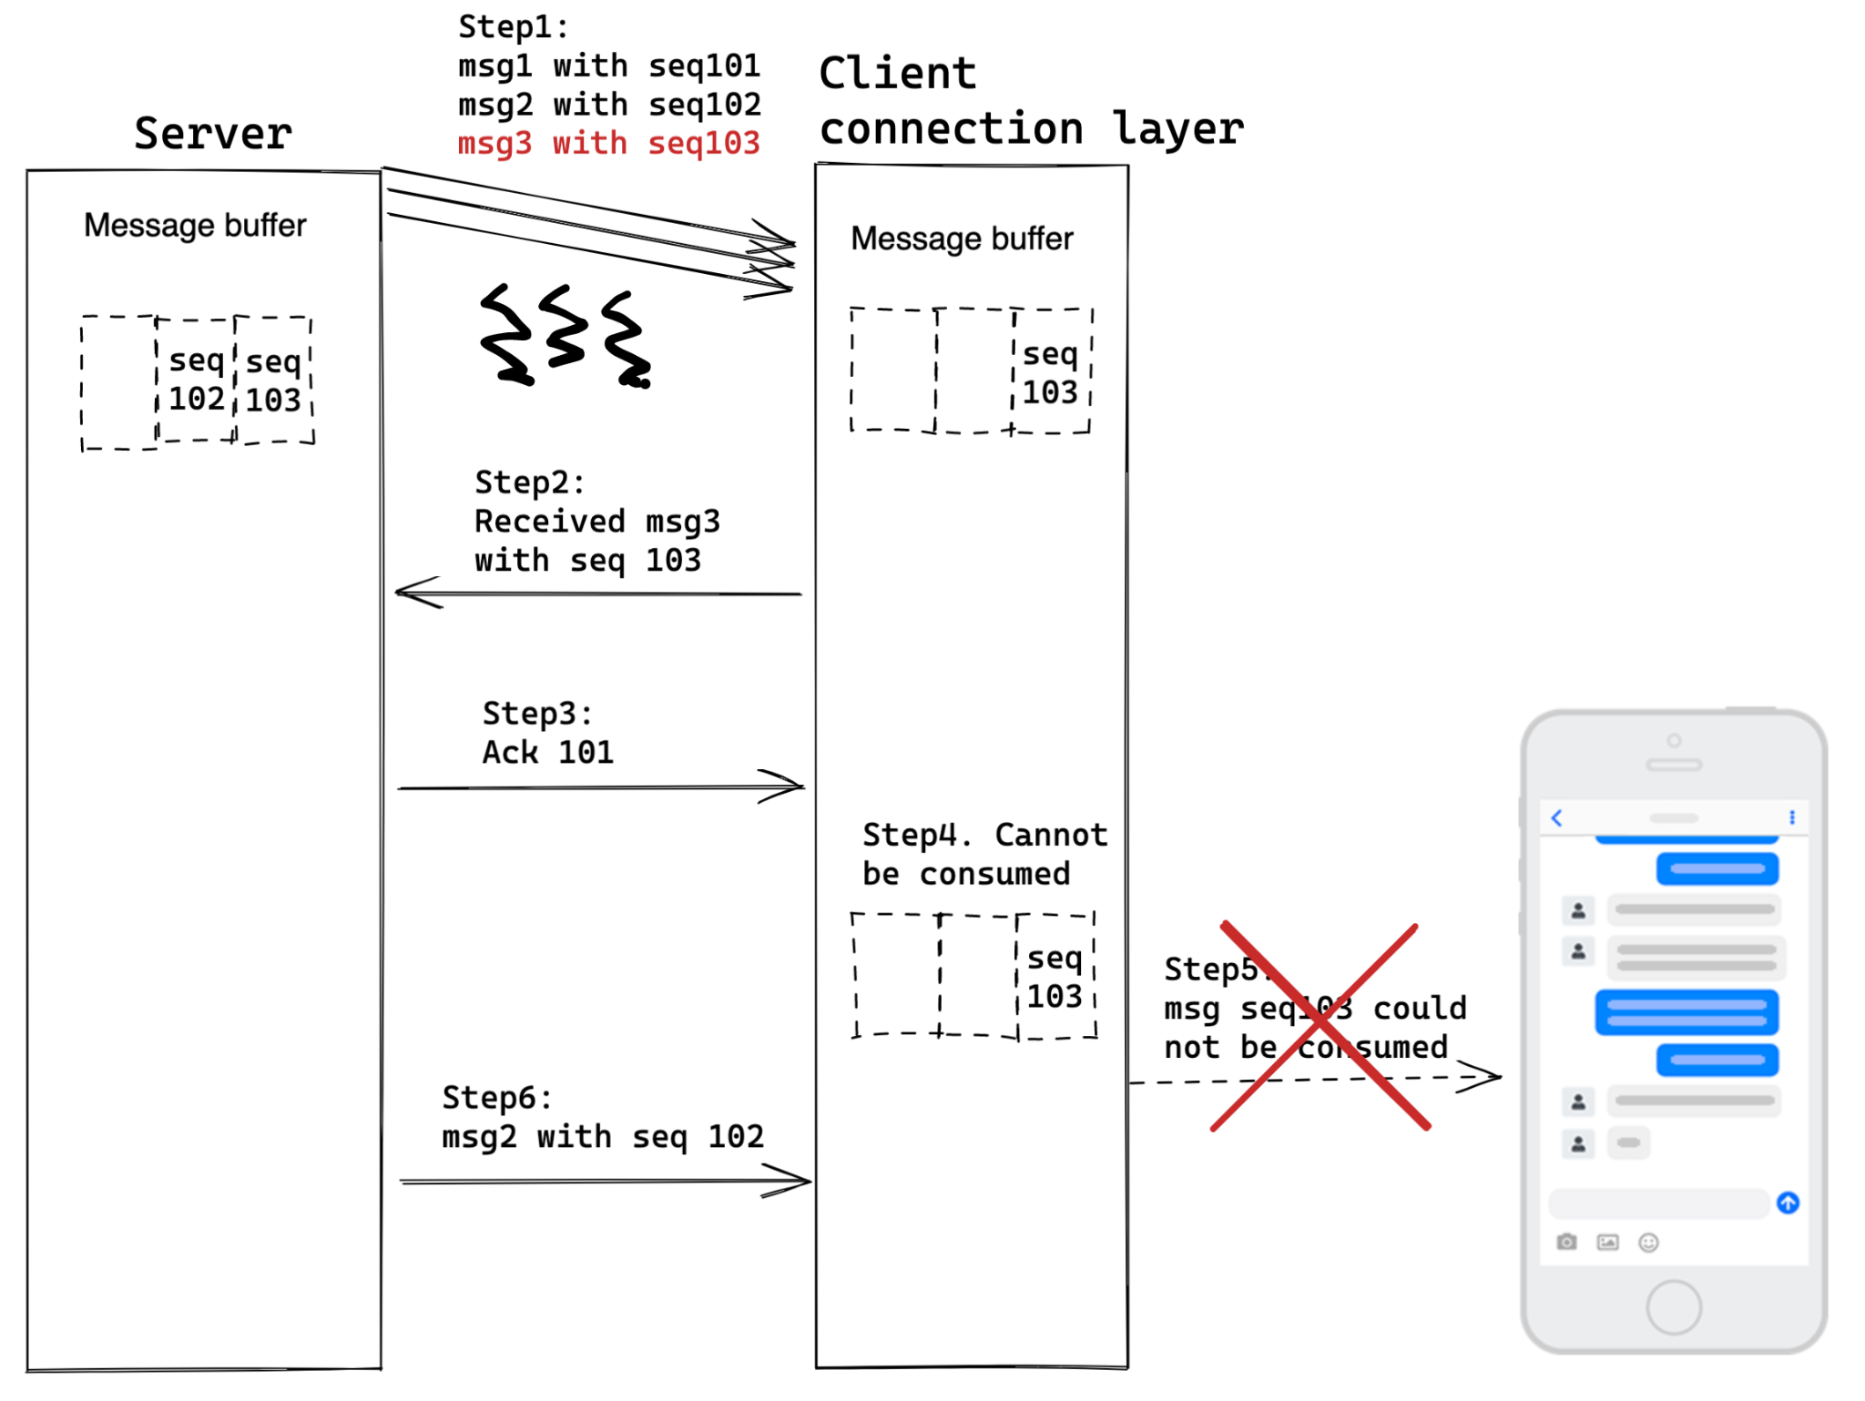
NonFunc - Ordering
Buffer queue
Msg out of order

Slide 41
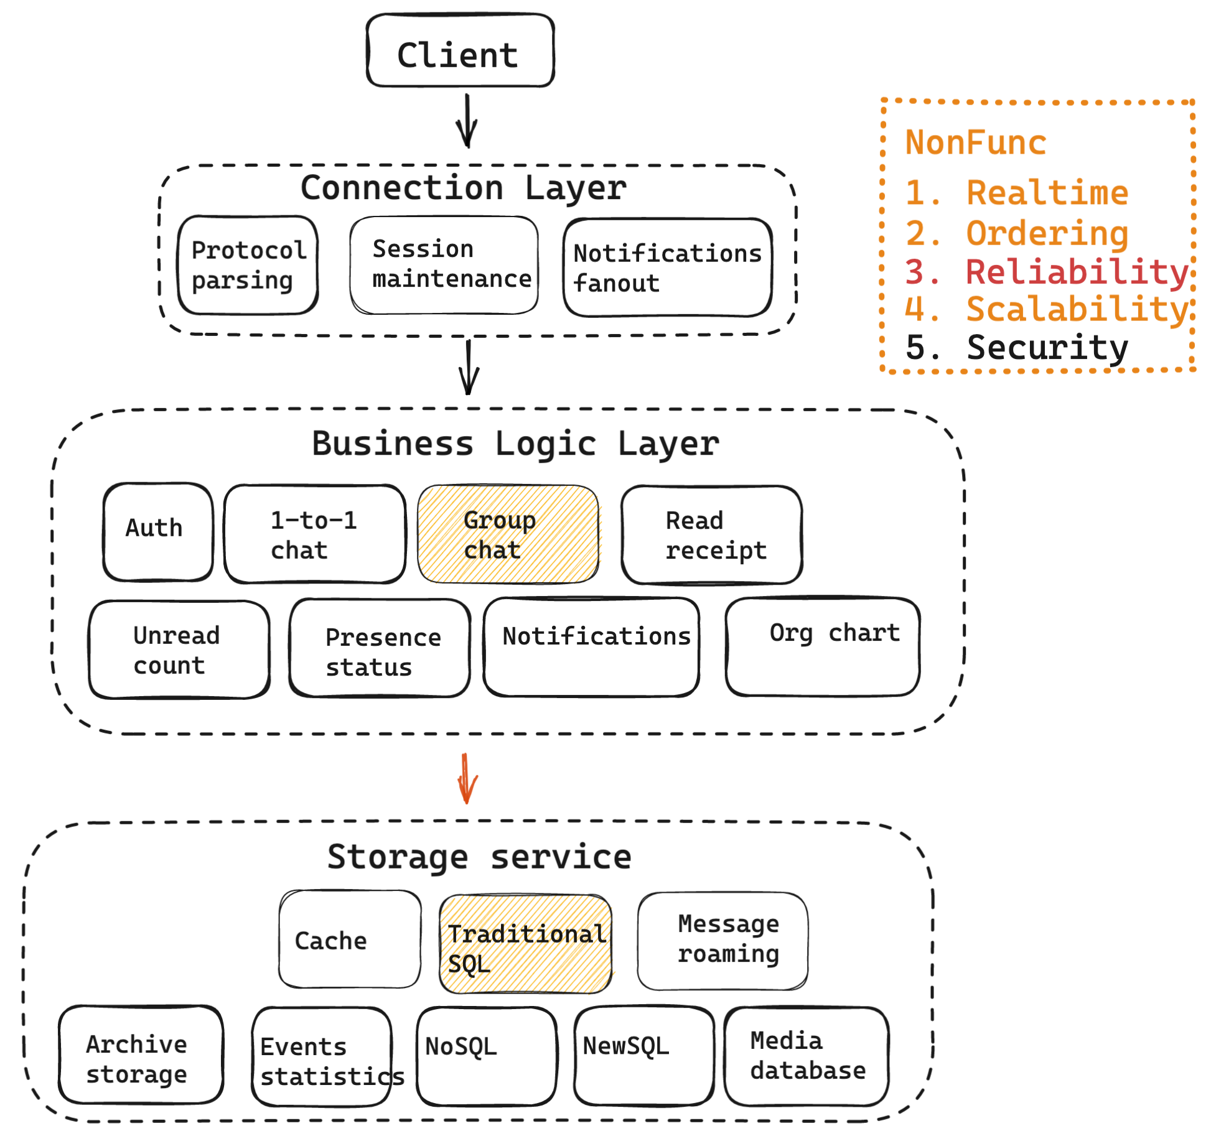
NonFunc - Reliability
Goal: No miss, No dupe
Two ideas

Slide 42
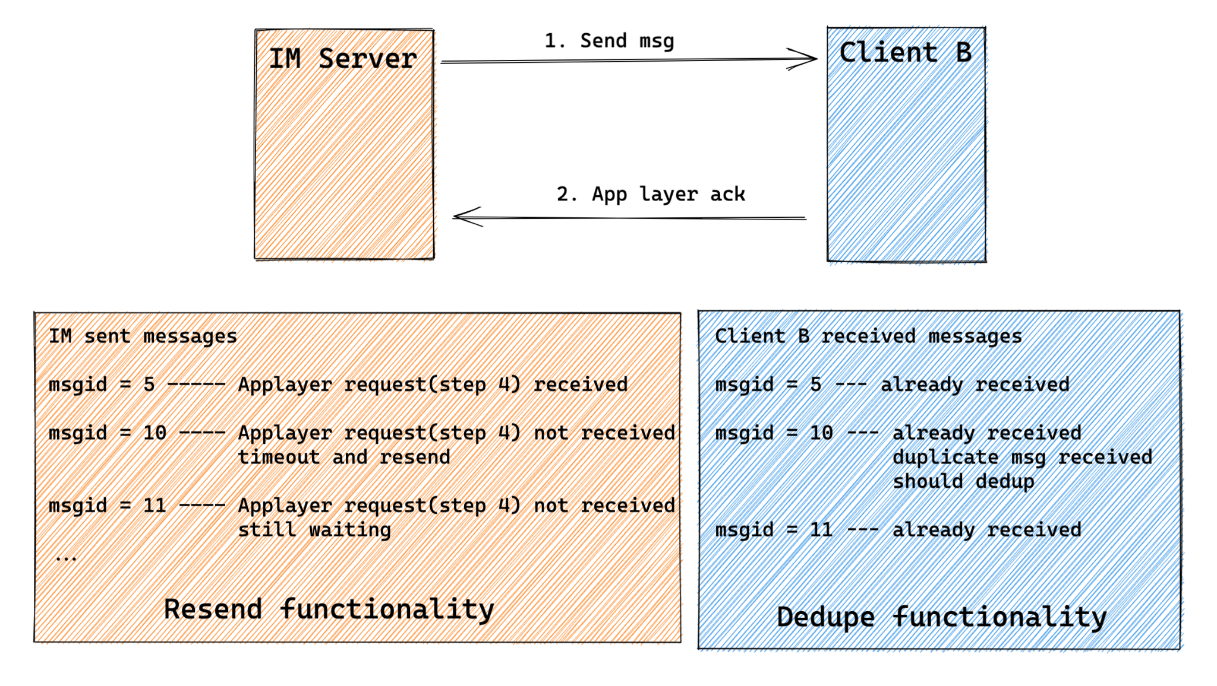
NonFunc - Reliability - Resend and dedup
Love good msgId
Easy if global unique
A bit complicated if per conversation
Scenario:
Network jittery
Notes:
Two ways of reliability: http://www.52im.net/thread-1470-1-1.html
Multiple dimensions of thinking about reliability: http://www.52im.net/thread-3445-1-1.html

Slide 43
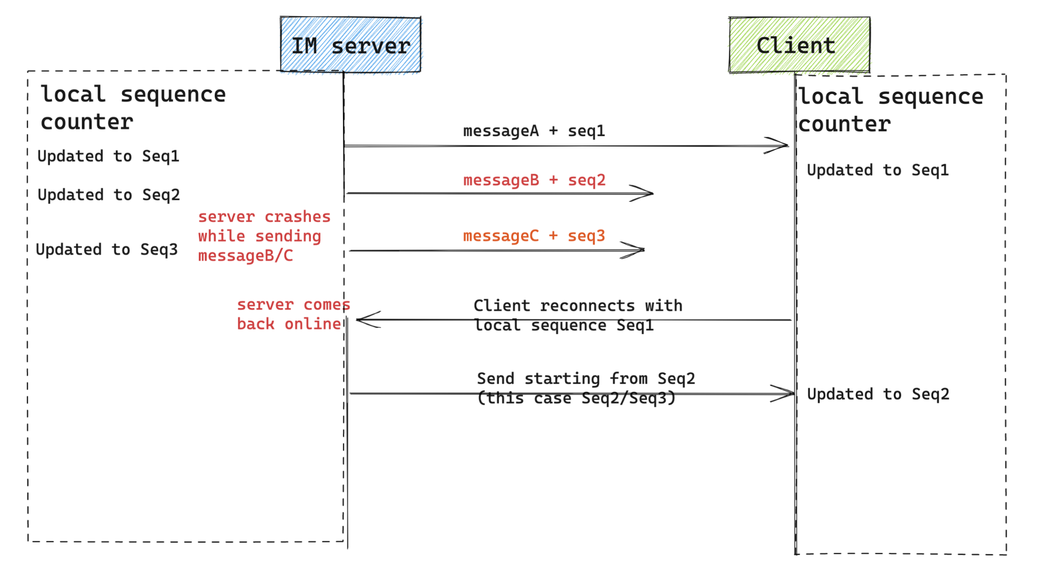
NonFunc - Reliability - Local sequence counter
Scenario:
Server crash
Notes:
Two ways of reliability: http://www.52im.net/thread-1470-1-1.html
Multiple dimensions of thinking about reliability: http://www.52im.net/thread-3445-1-1.html

Slide 44
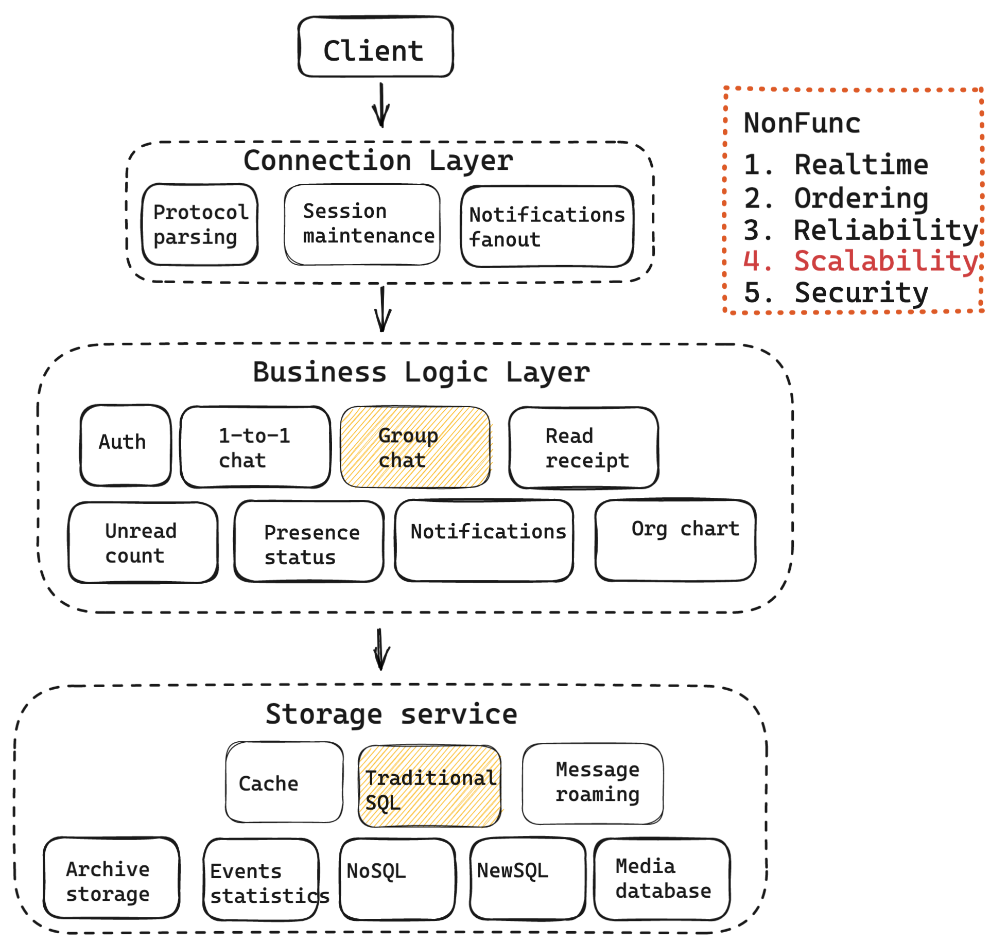
NonFunc - Scalability
Large group? 10K size
not like telegram 200K
Two ideas

Slide 45
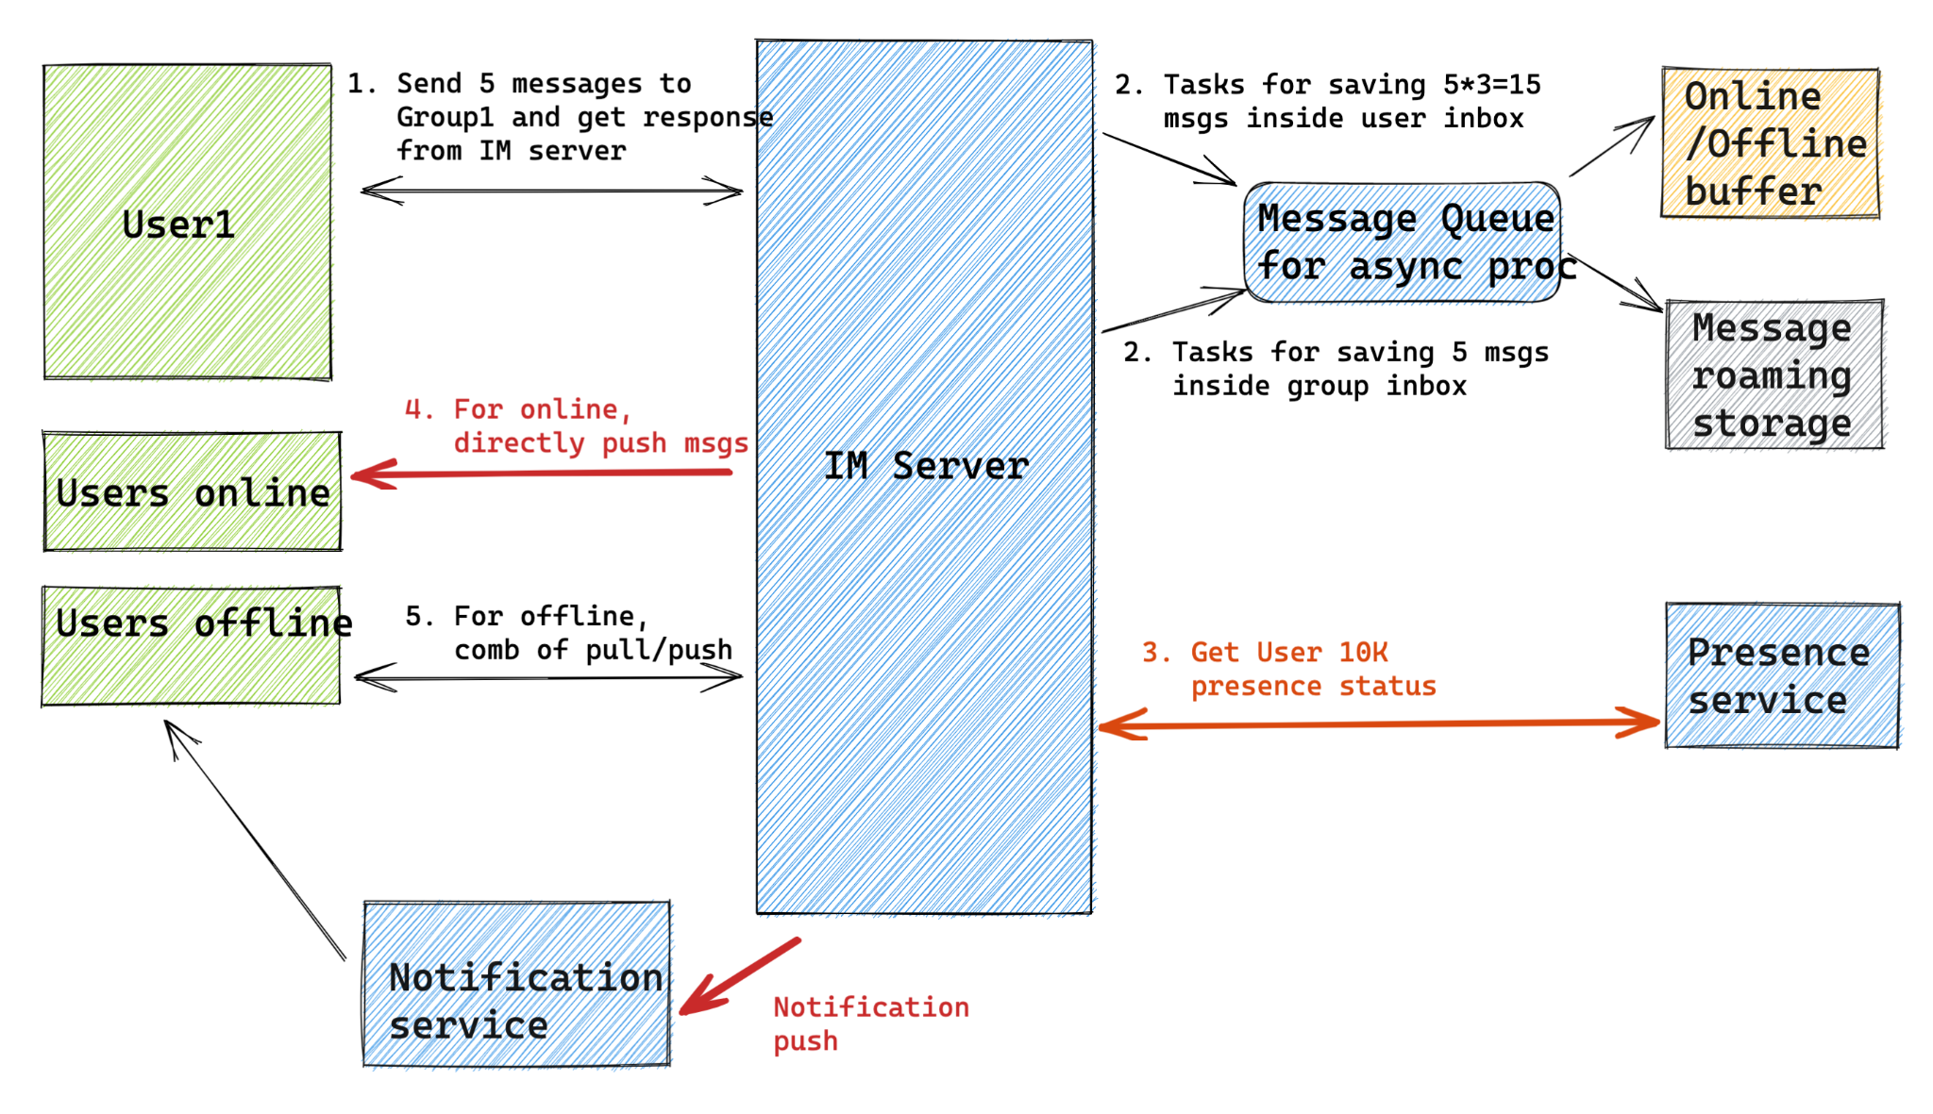
NonFunc - Scalability - Batch operations
Batch operations

Slide 46
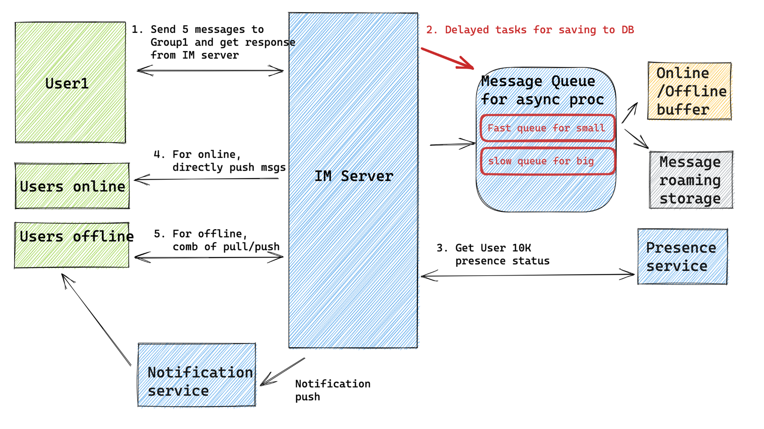
NonFunc - Scalability - Batch operations
Database is still bottleneck
Delayed msg queue tasks for writing to DB
Different speed queue
Change DB?

Slide 47
Future topics
Anything related to Multimedia: video/audio
Popular features in IM products
Unread count
Typing indicators
Sharing real time location
Sharing files
Message reactions
1:1 chat
Popular 2B messenger features
Recall message in longer time period
Org chart
Read receipt
Platform level optimization

Slide 48
Summary
References:
即时通讯网
二手车瓜子消息系统
即时消息技术剖析与实战

